Slide 1
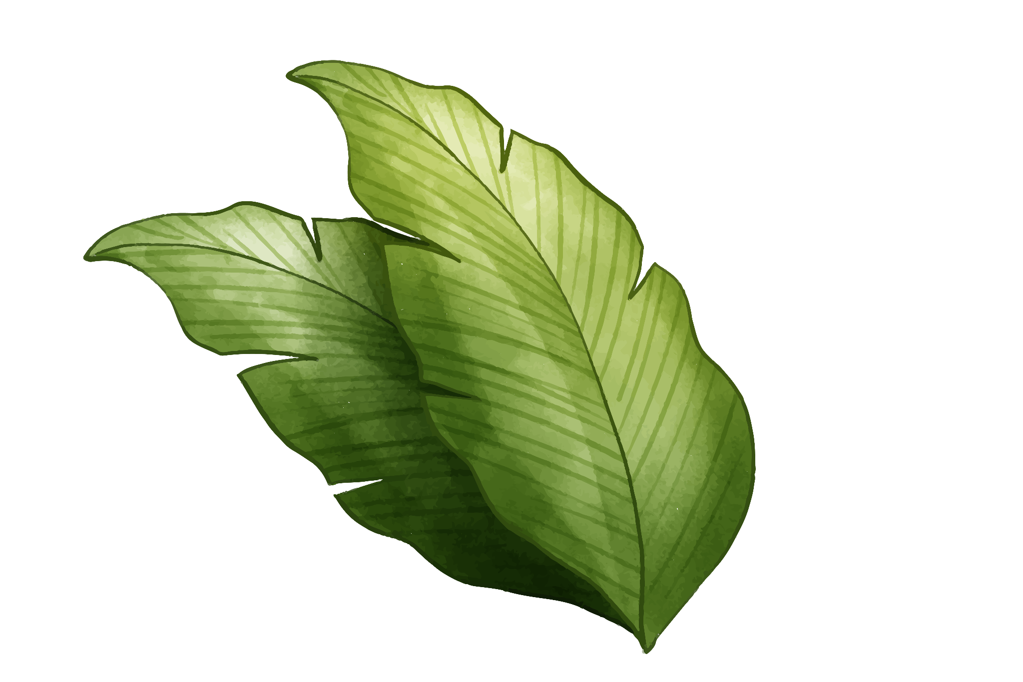
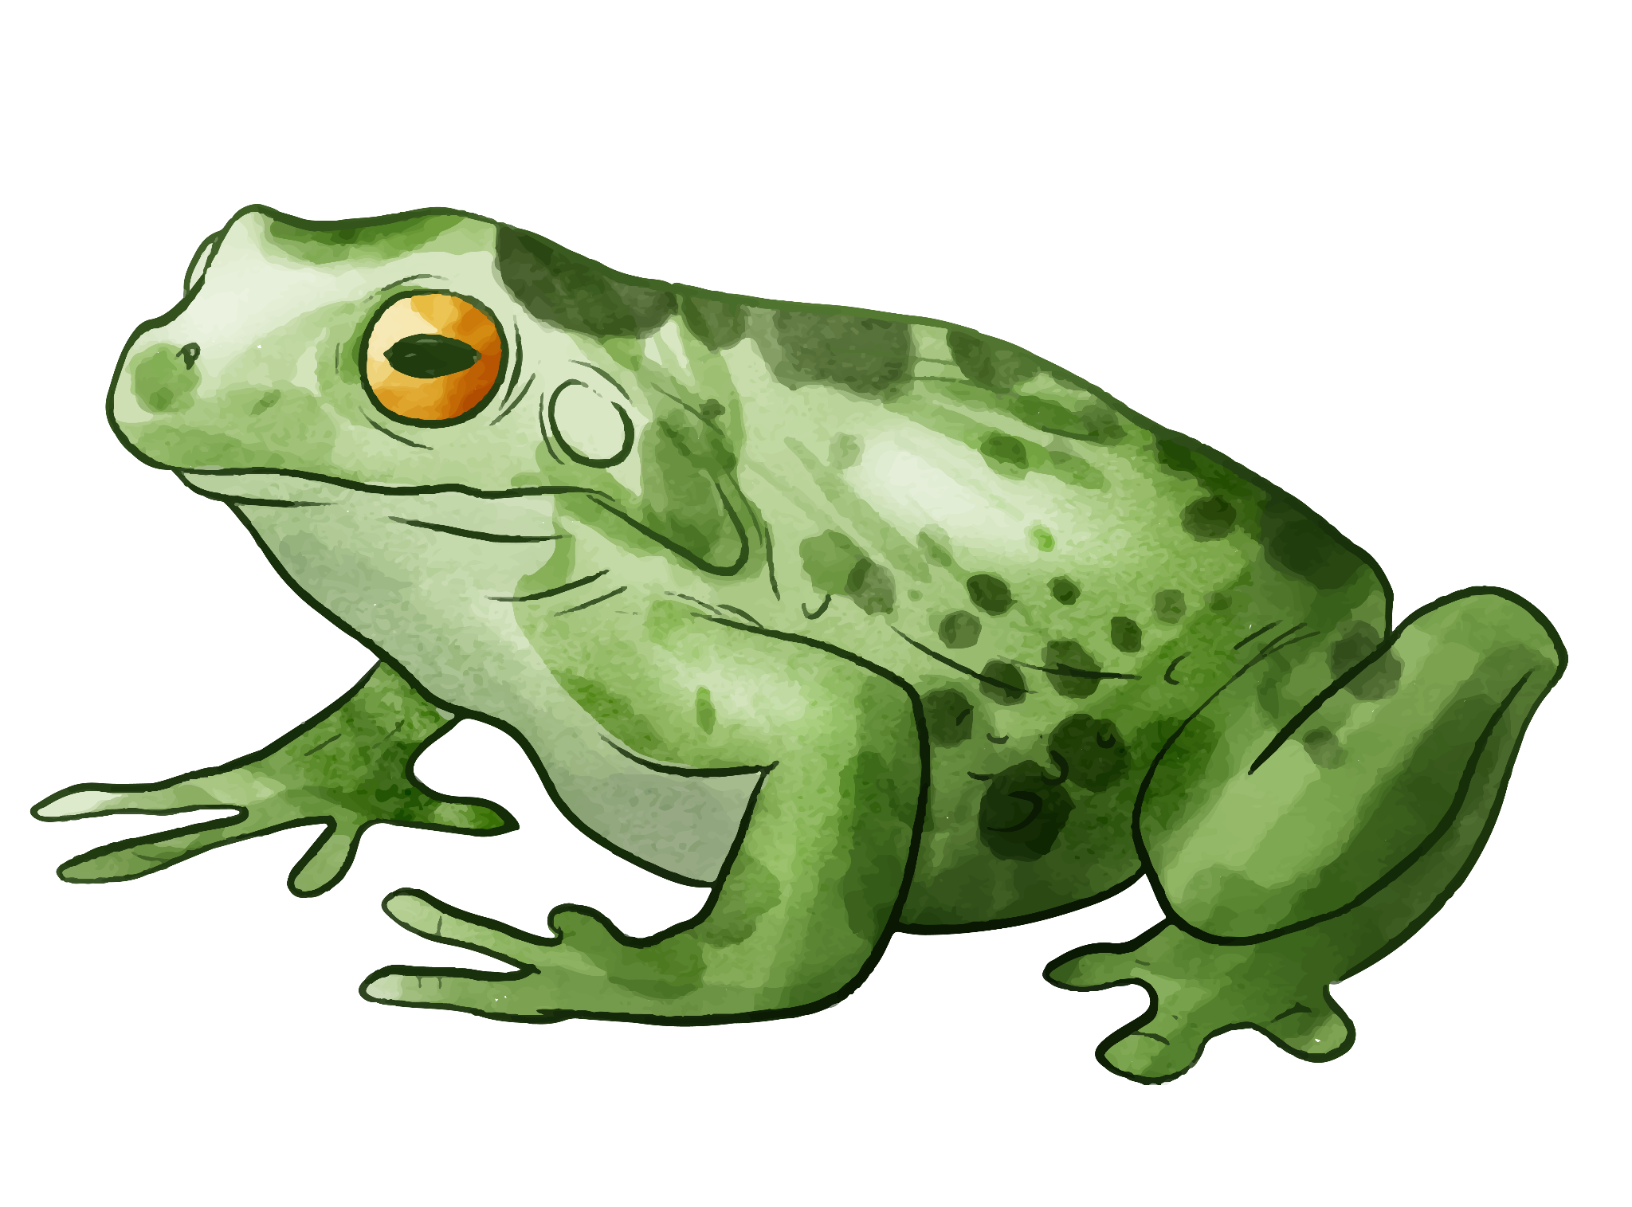
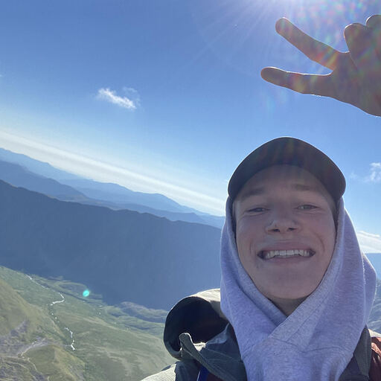
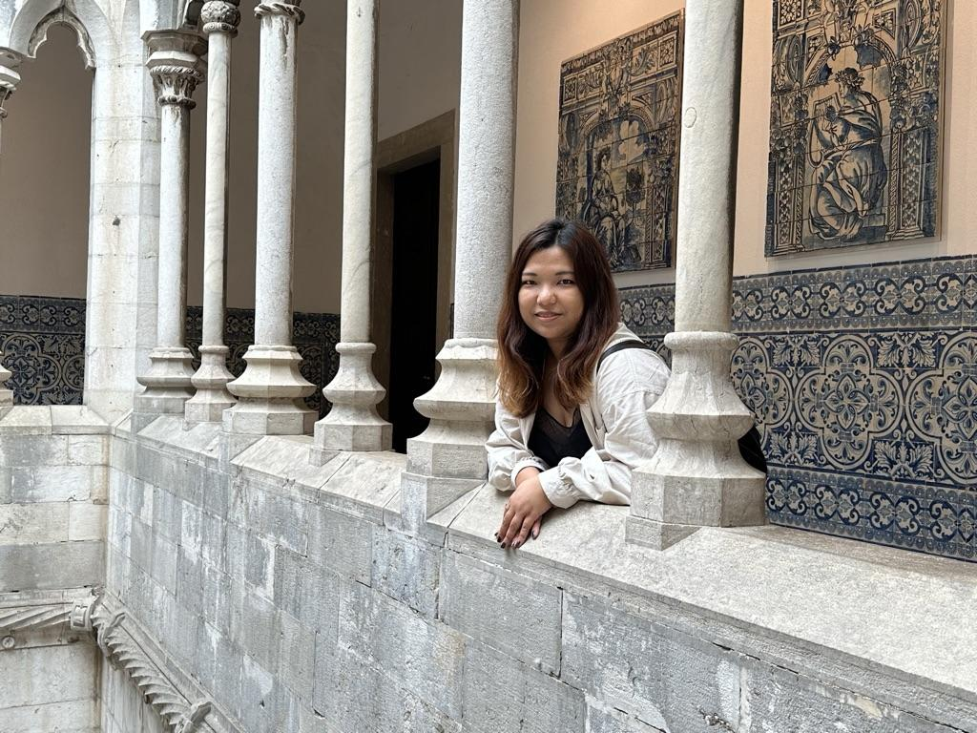

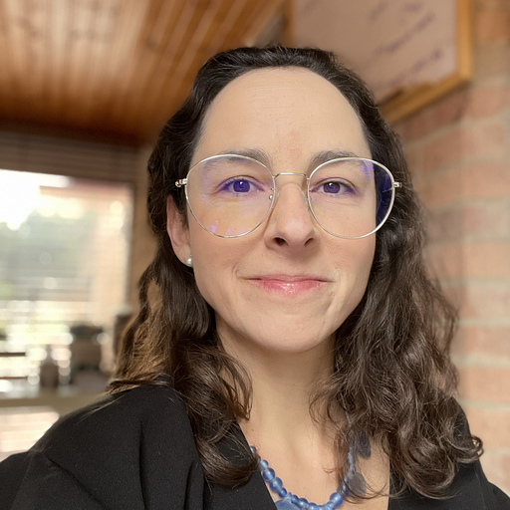
Colombian
Wildlife Classification
Henry Gardner Jacqueline Lam Eunice Ngai Juliana Gómez
Notes:
Henry

Slide 2
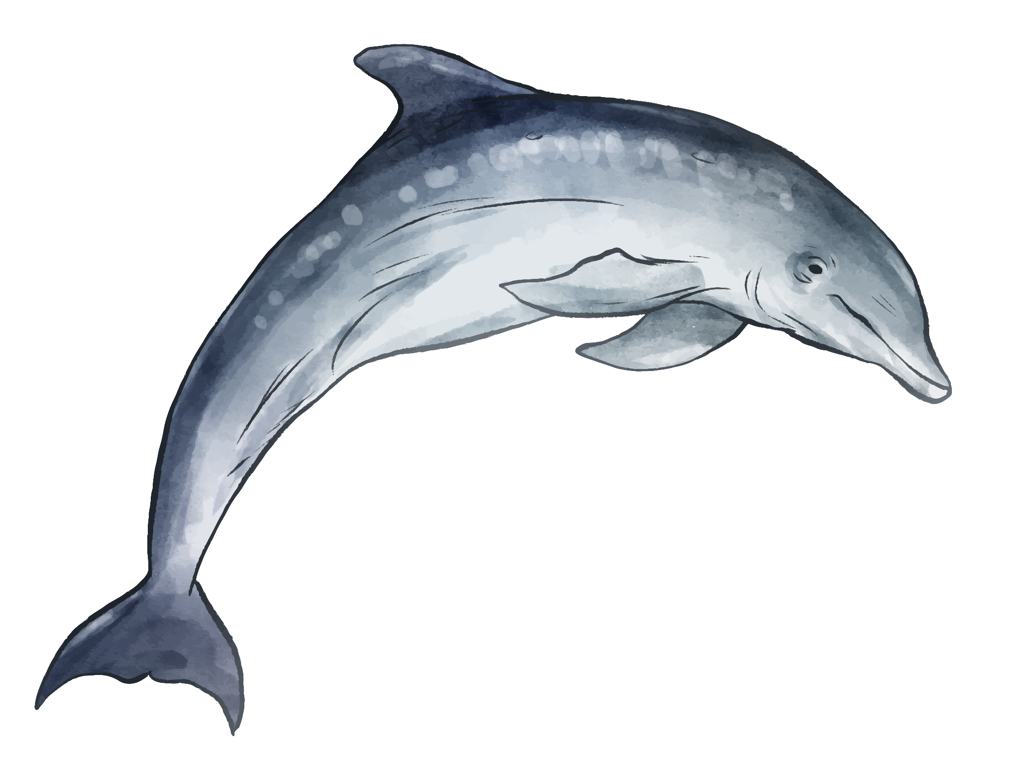
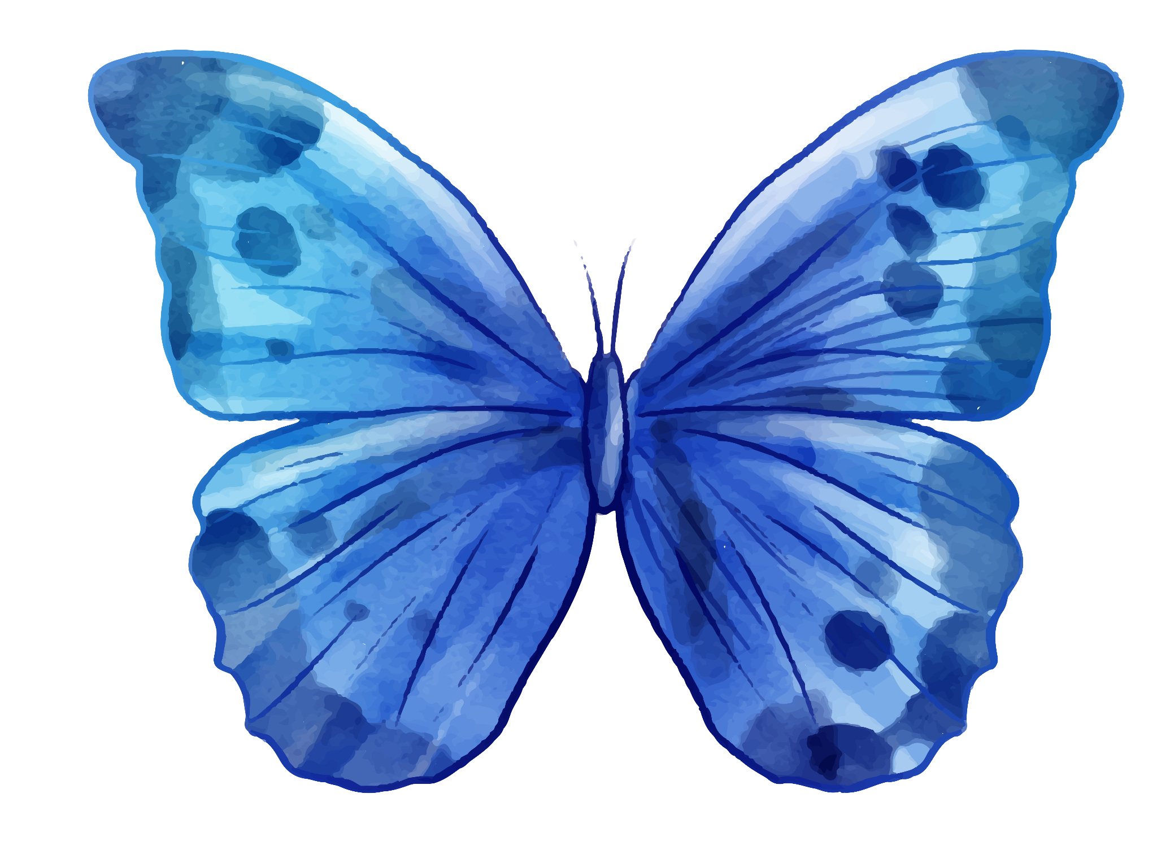
Table of contents
01.
02.
03.
04.
The data
Data preprocessing
Feature extraction
Classifiers
Notes:
Henry

Slide 3
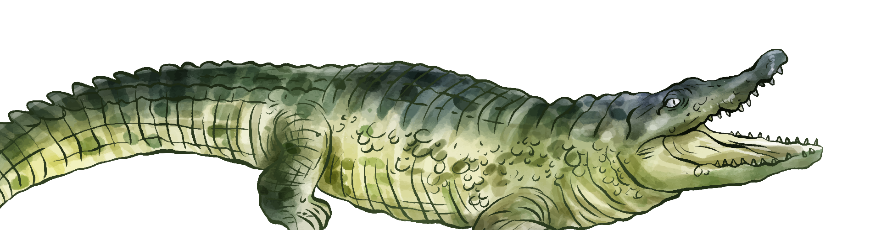
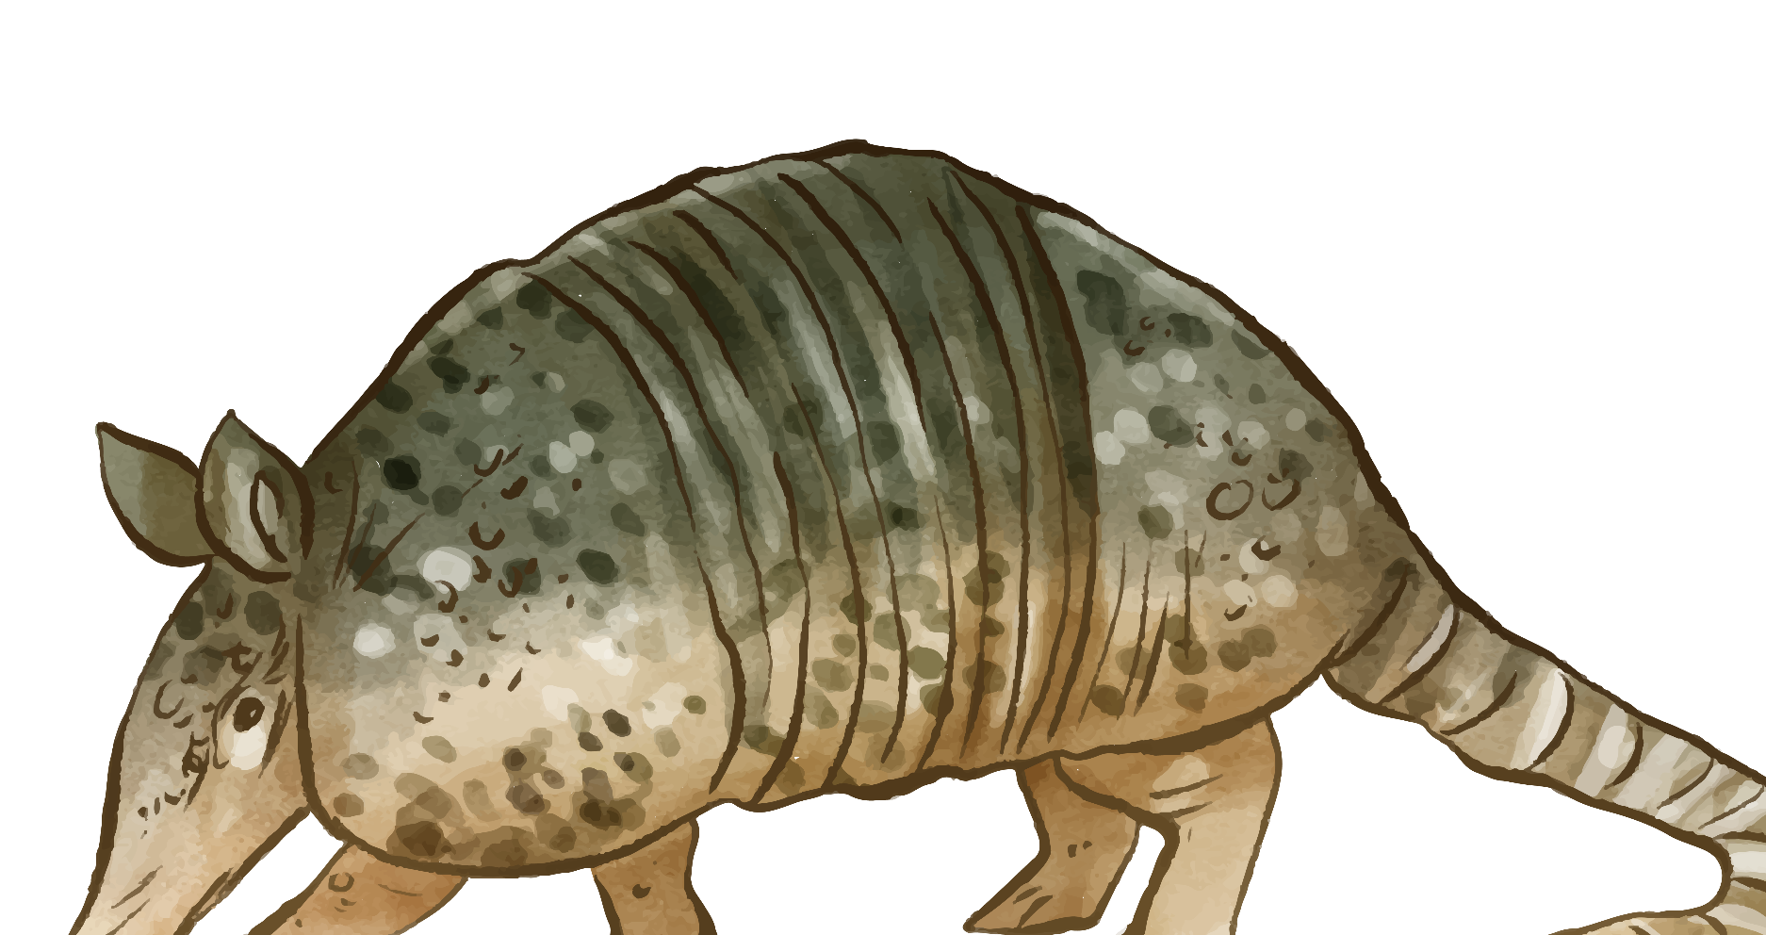
01.
The
data
Notes:
Henry

Slide 4
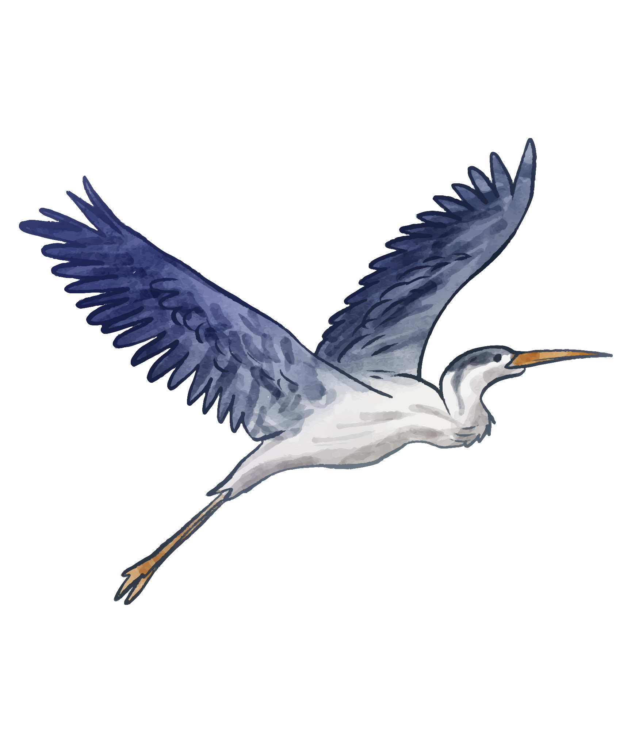
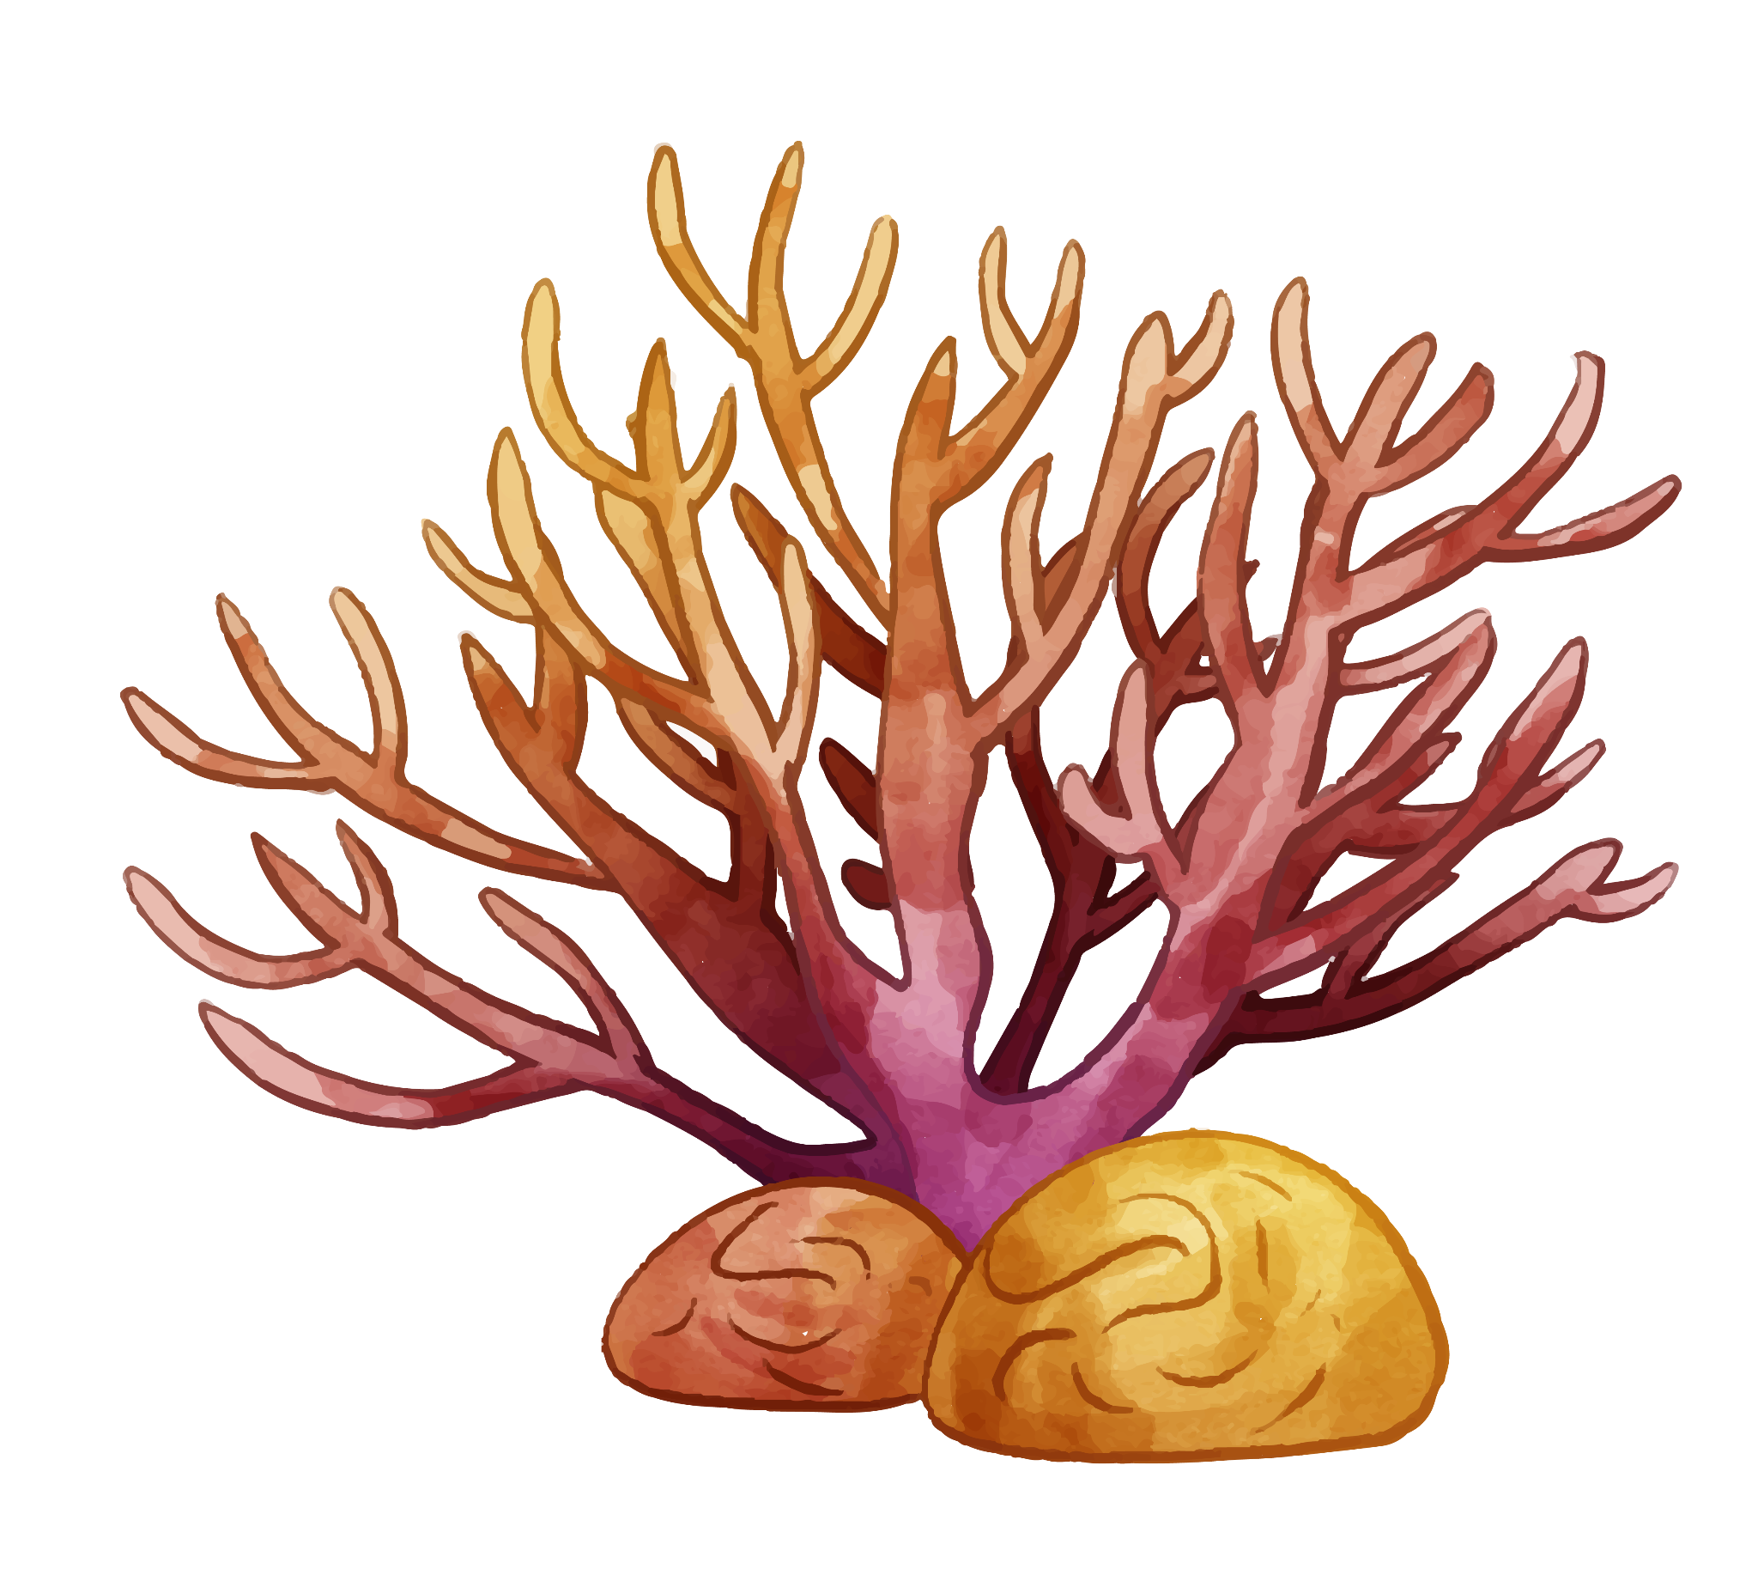
Orinoquía Camera Traps LILA BC
Originally:
100K images of vertebrate animals
50 cameras from 2 natural reserves
RGB / infrared
51 animal species + blank + humans
Unbalanced
Notes:
Henry

Slide 5
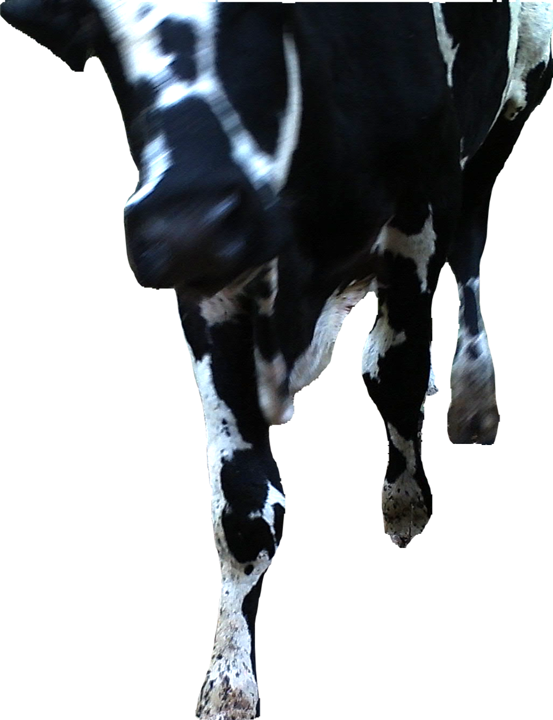
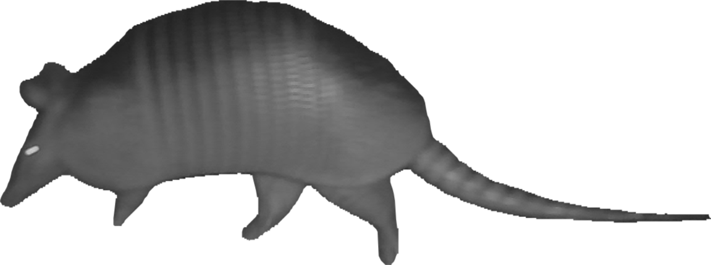
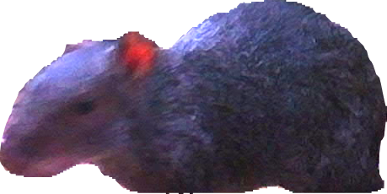
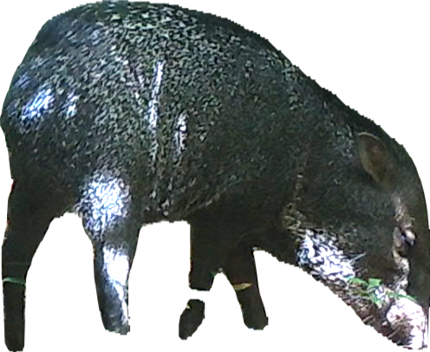
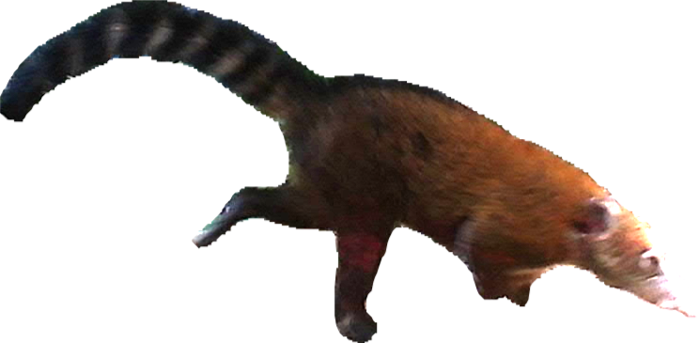
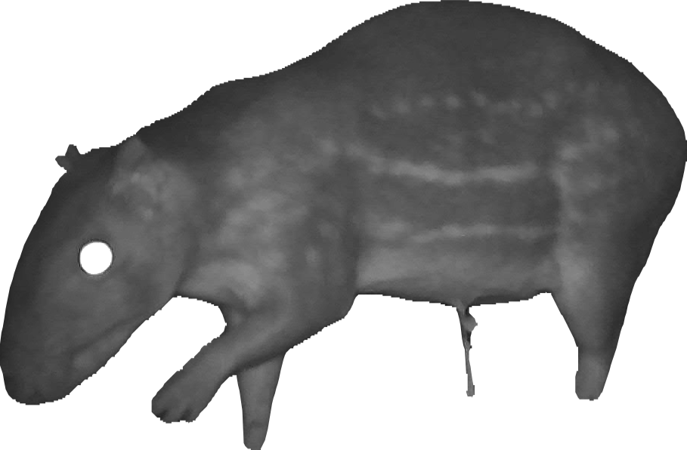
Our 6 classes
Black Agouti
Bos species (cow)
Dasypus species (armadillo)
Peccary
South American Coati
Spotted paca
Notes:
Henry
Real images from cameras, segmented using https://segment-anything.com/
All are mammals:
Agouti: Rodent with strong, coarse fur.
Cow: One digit for walking, udders.
Armadillo: Cingulata - Dasypodidae (most closely related to ant-eaters and sloths). Armed plates.
Peccary: an ungulate, closely related to pigs. Two digits for walking, long snout.
Coati (“Long nose”): a carnivorous mammal, closely related to a raccoon (including the banded tail)
Paca: Rodent, closely related to pacas - dots and stripes on their sides, short ears, and barely visible tails
Since there were so many classes and images, we wanted to narrow our approach to classify one of these 6 animals. These were specifically chosen to have both distinct and similar features as to test the robustness of our feature extraction. Clearly, the classes share similarities in both body and tail shape, which led to inevitable challenges that will be discussed later.

Slide 6
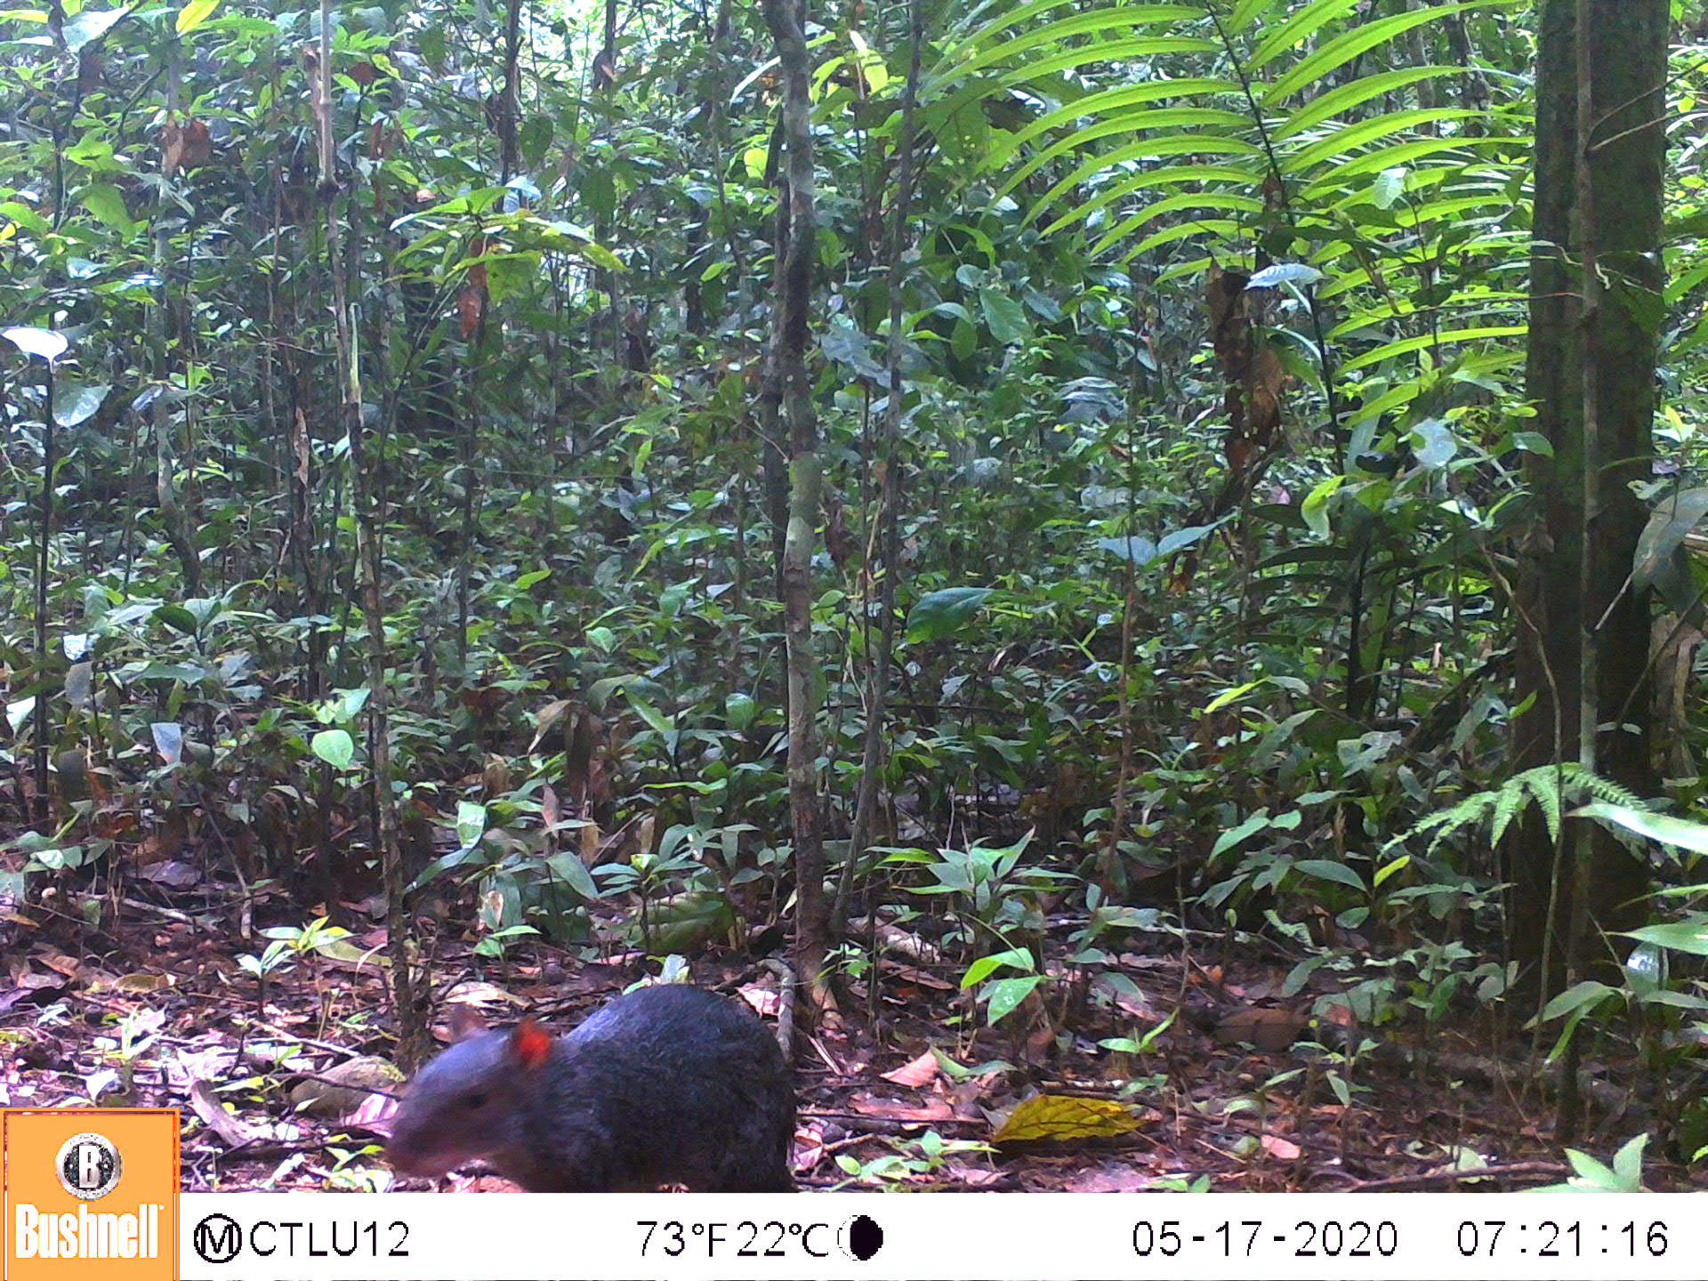
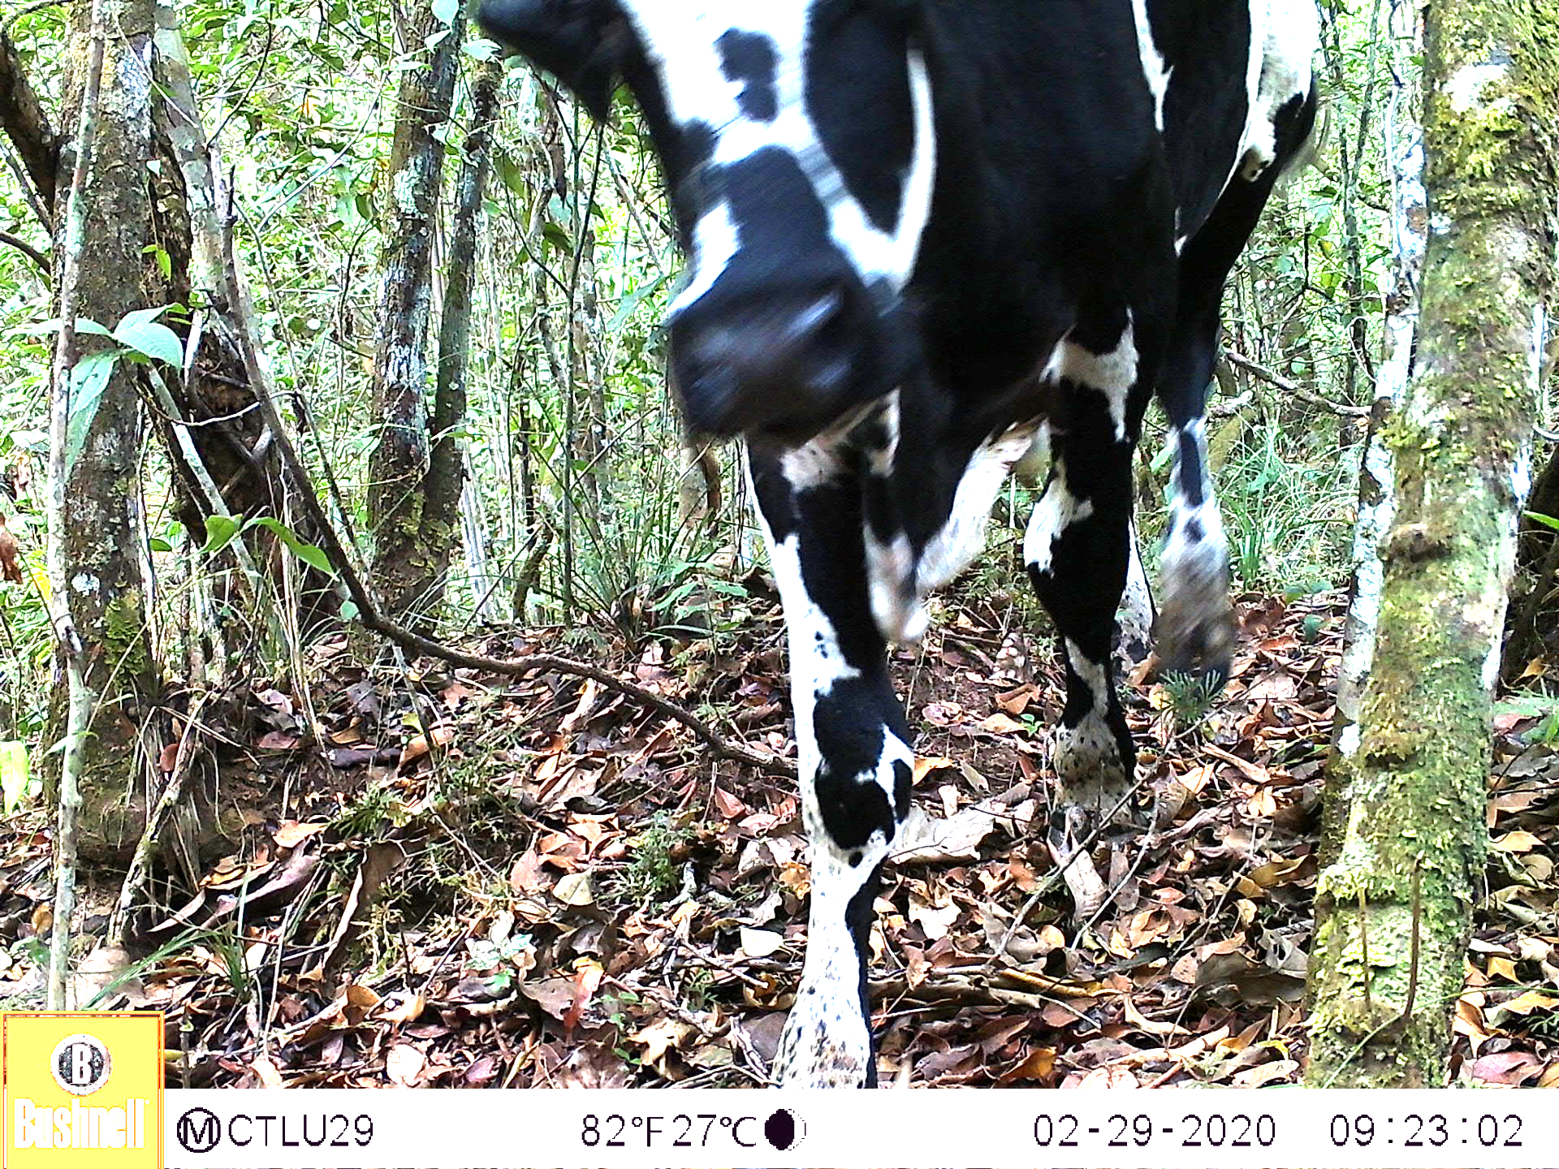
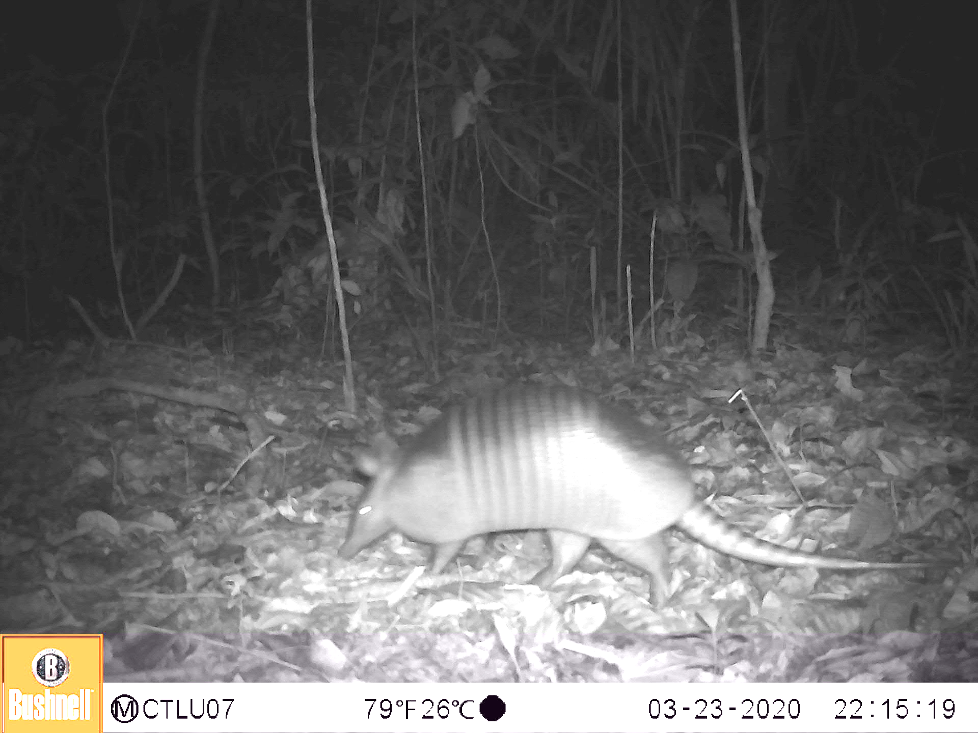
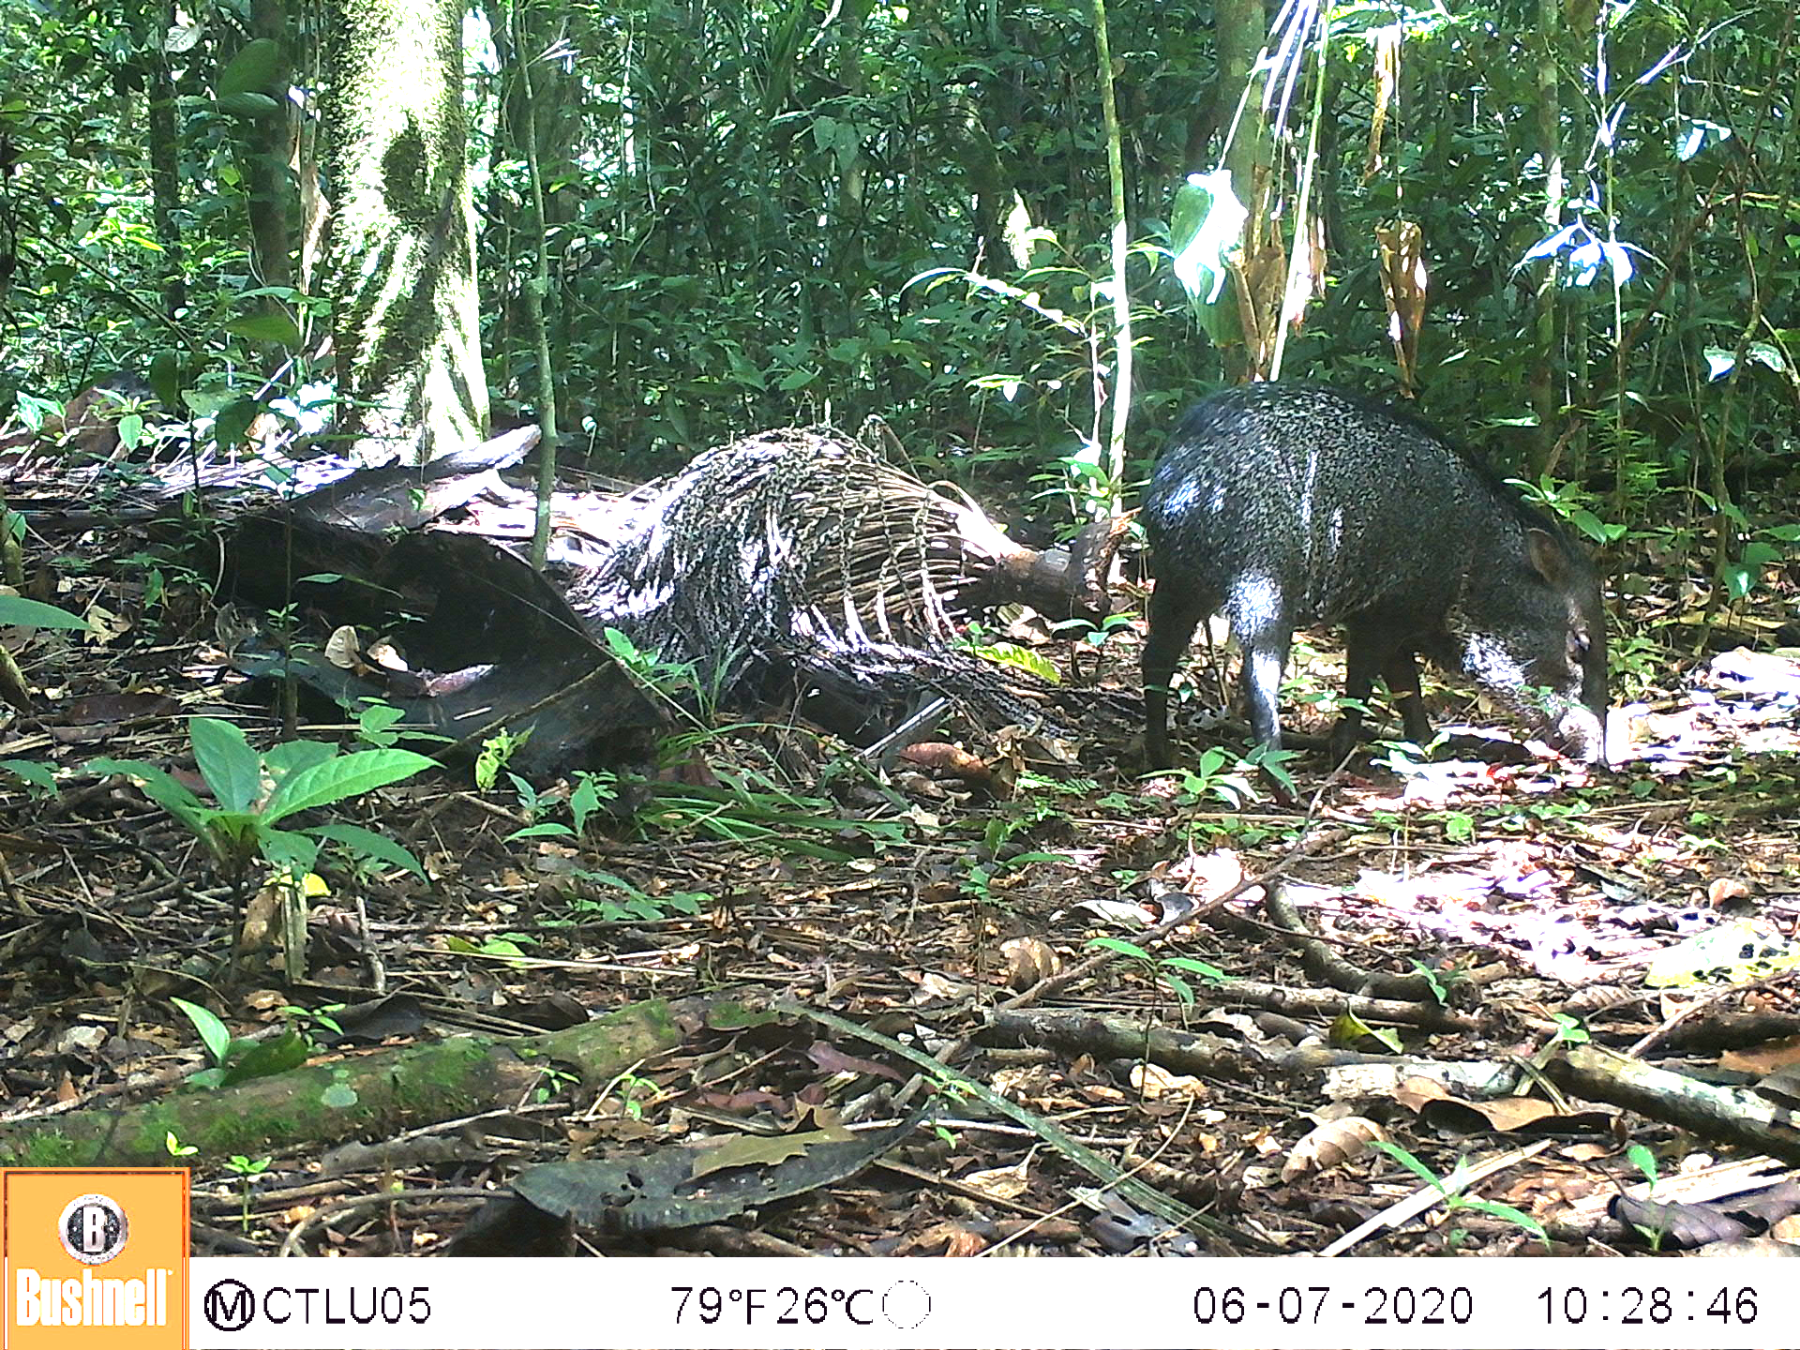
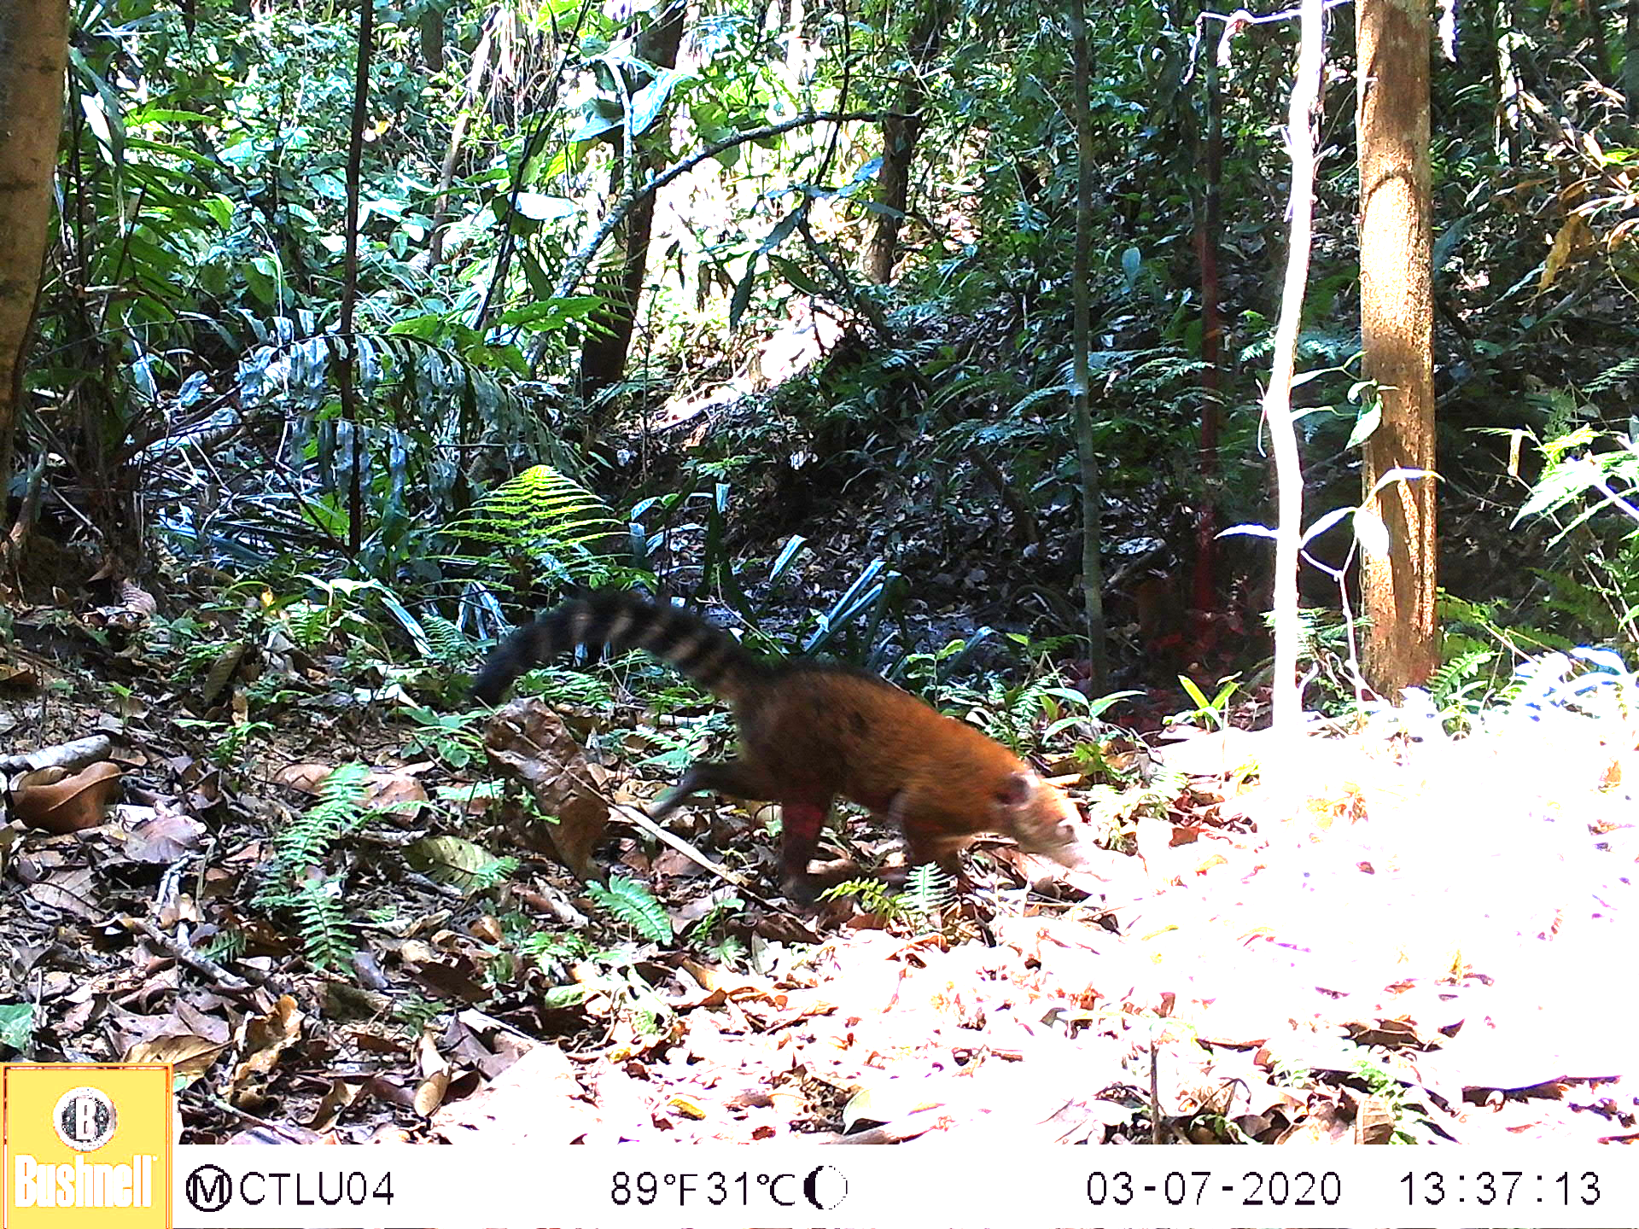
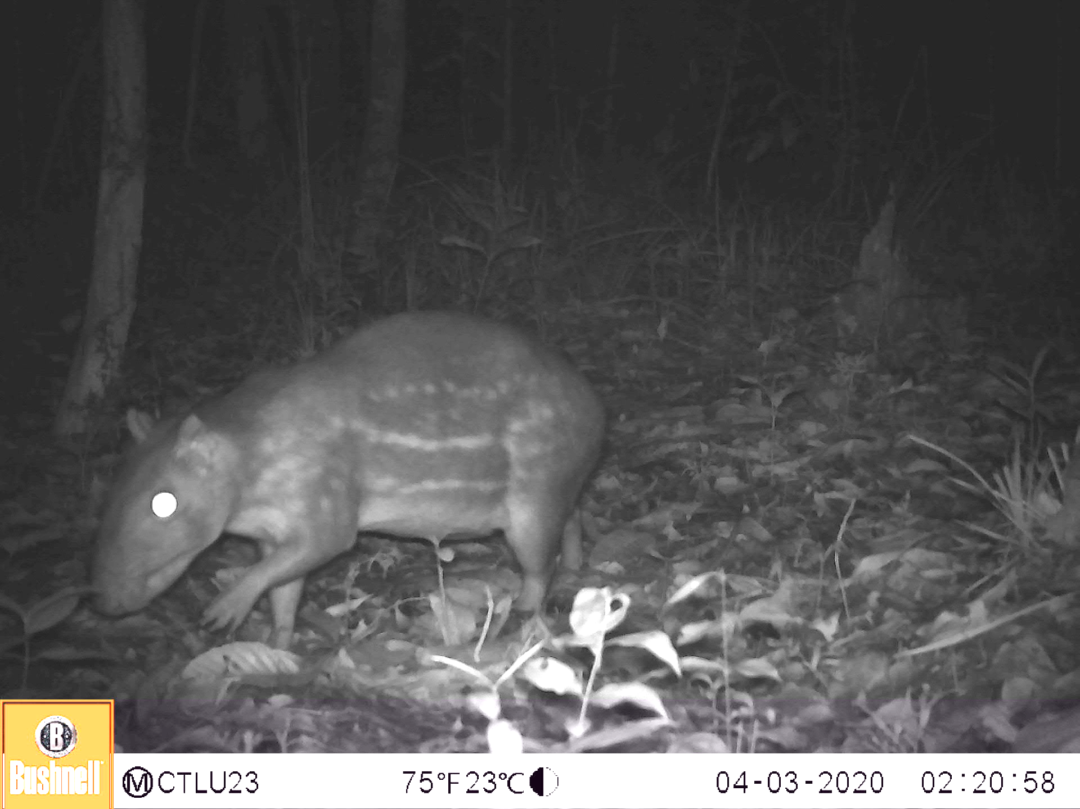
On their good days…
Black Agouti
Bos species (cow)
Dasypus species (armadillo)
Peccary
South American Coati
Spotted paca
Notes:
Henry
The image quality for classification varied dramatically. In the above images, it is very easy to identify the species as they are mostly in frame with distinct features that isolate to one of the six classes.

Slide 7
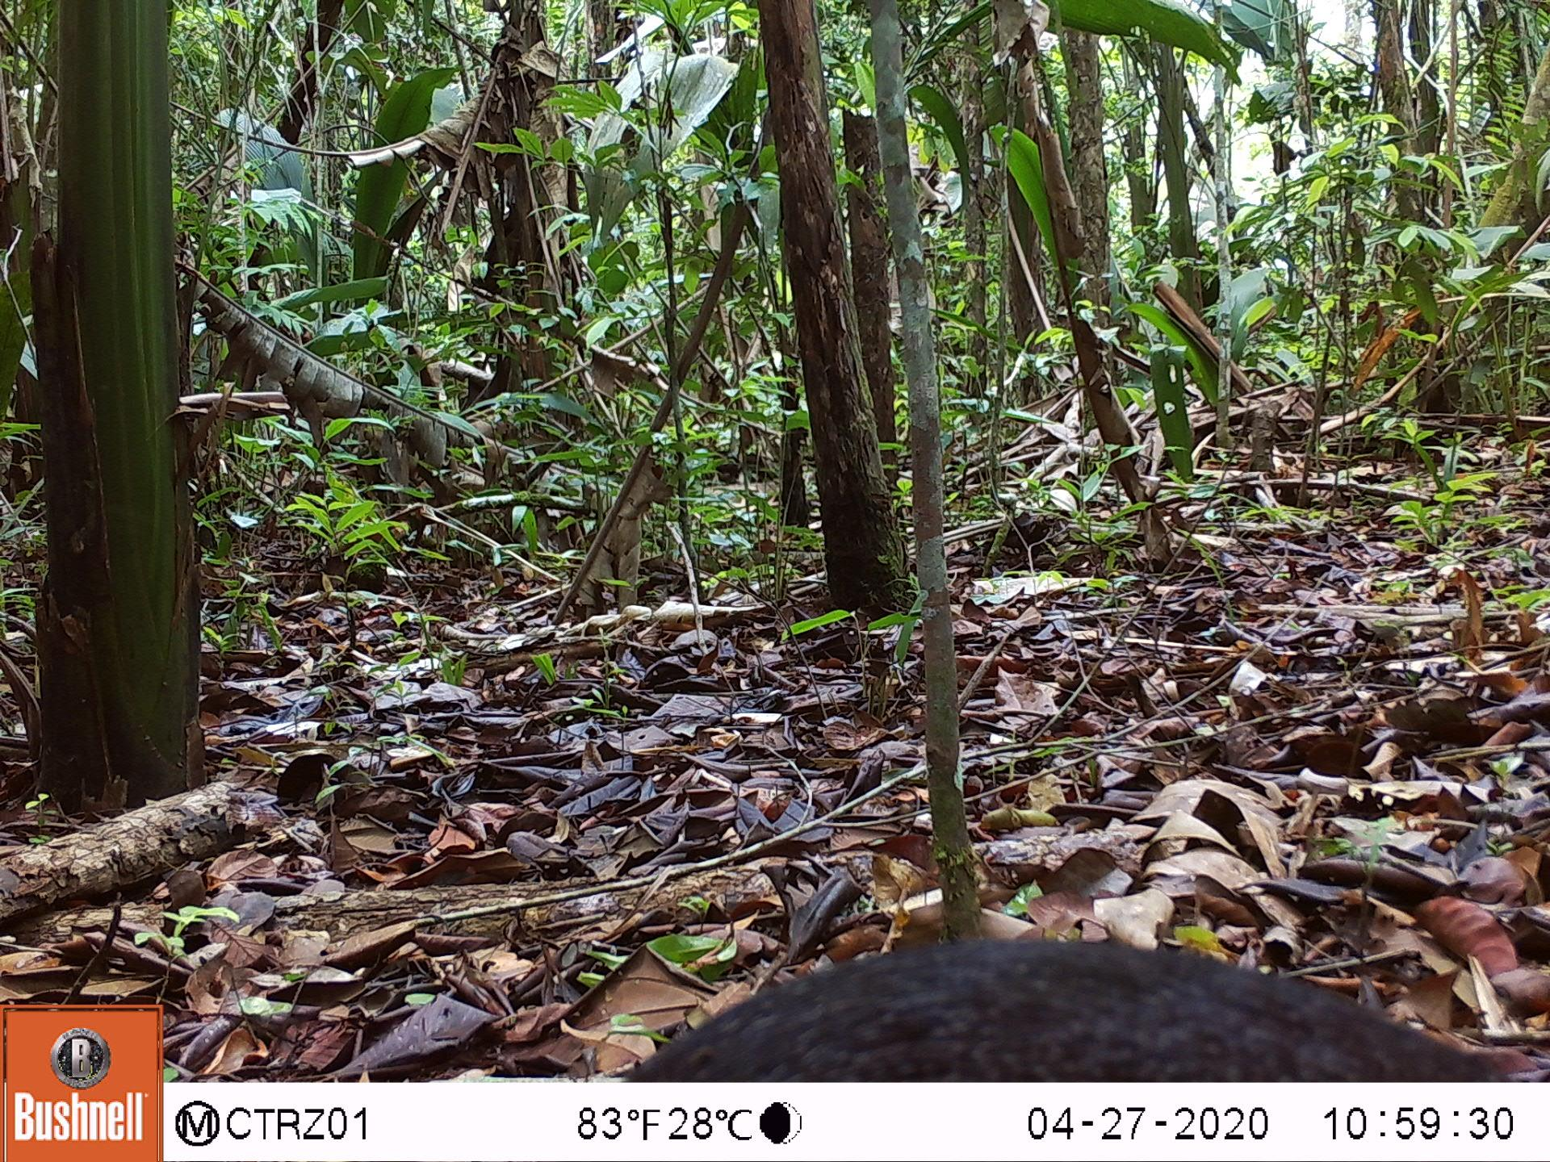
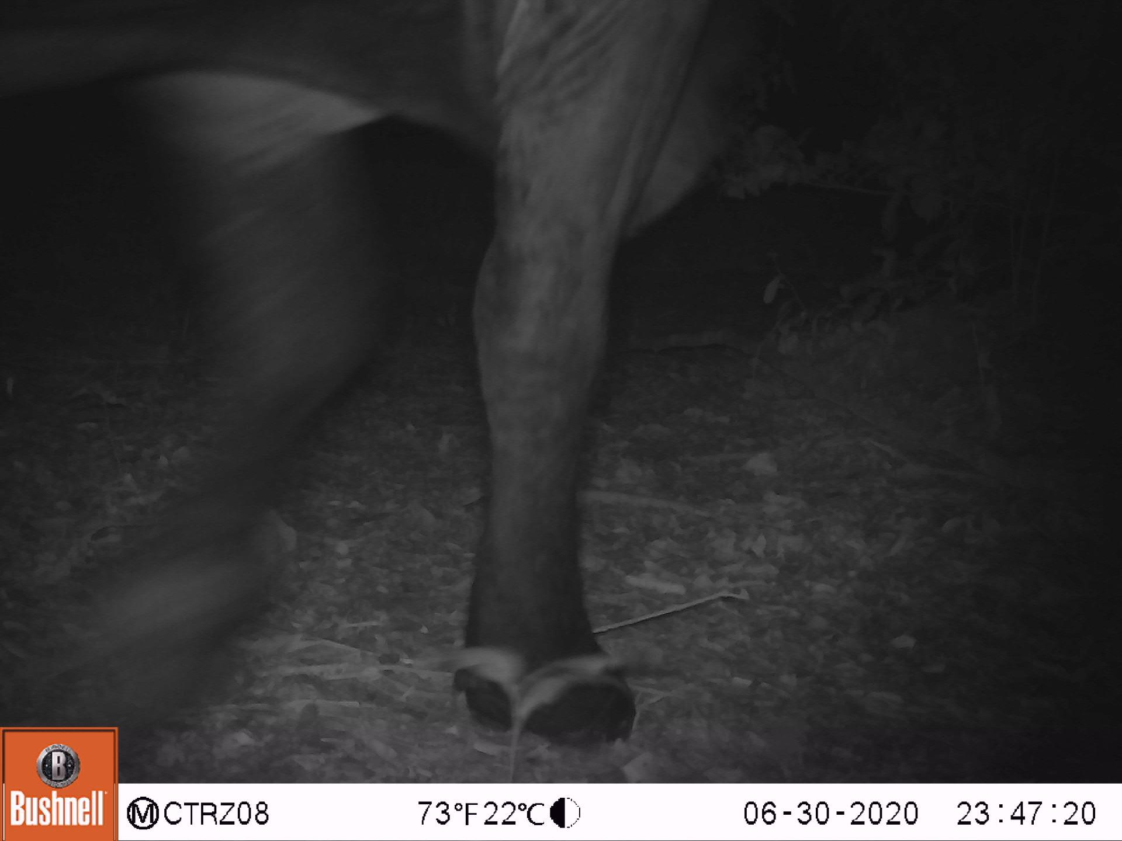
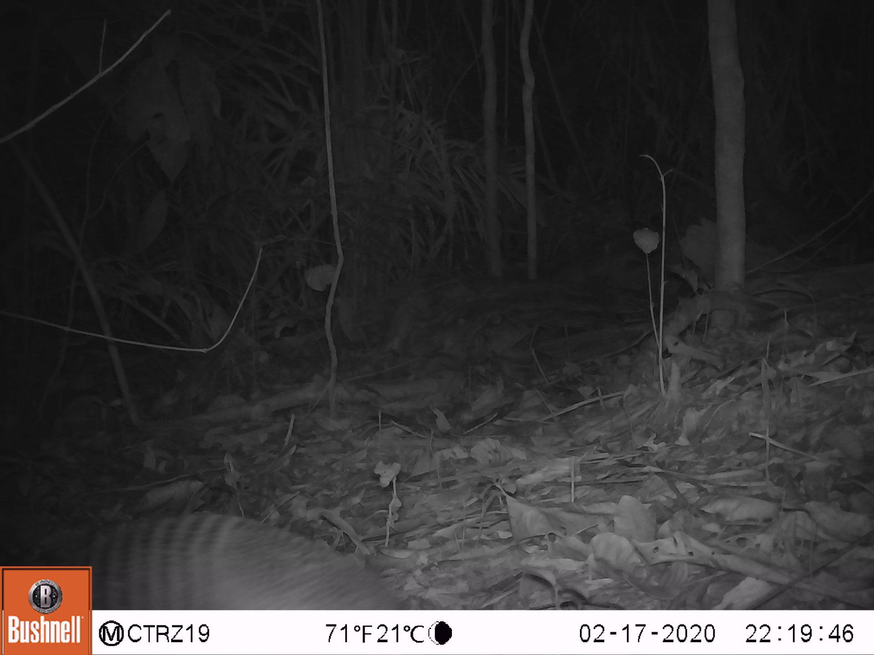
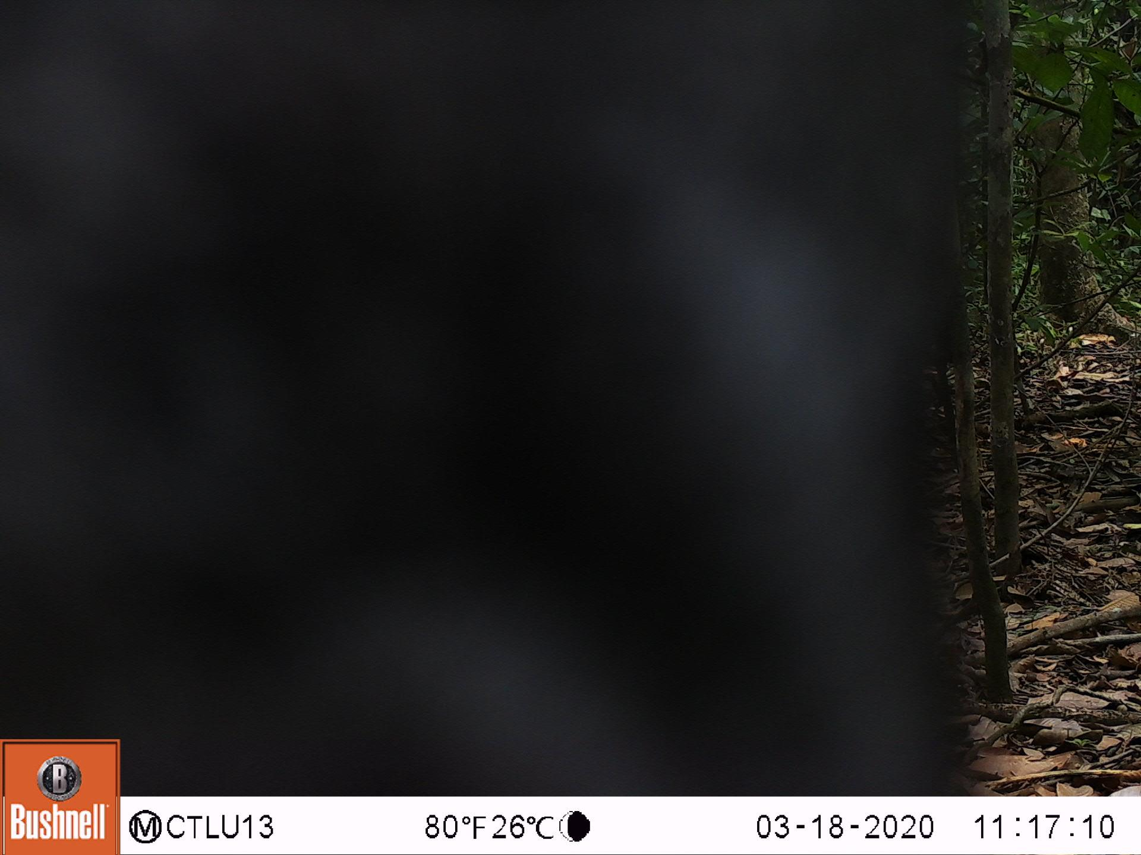
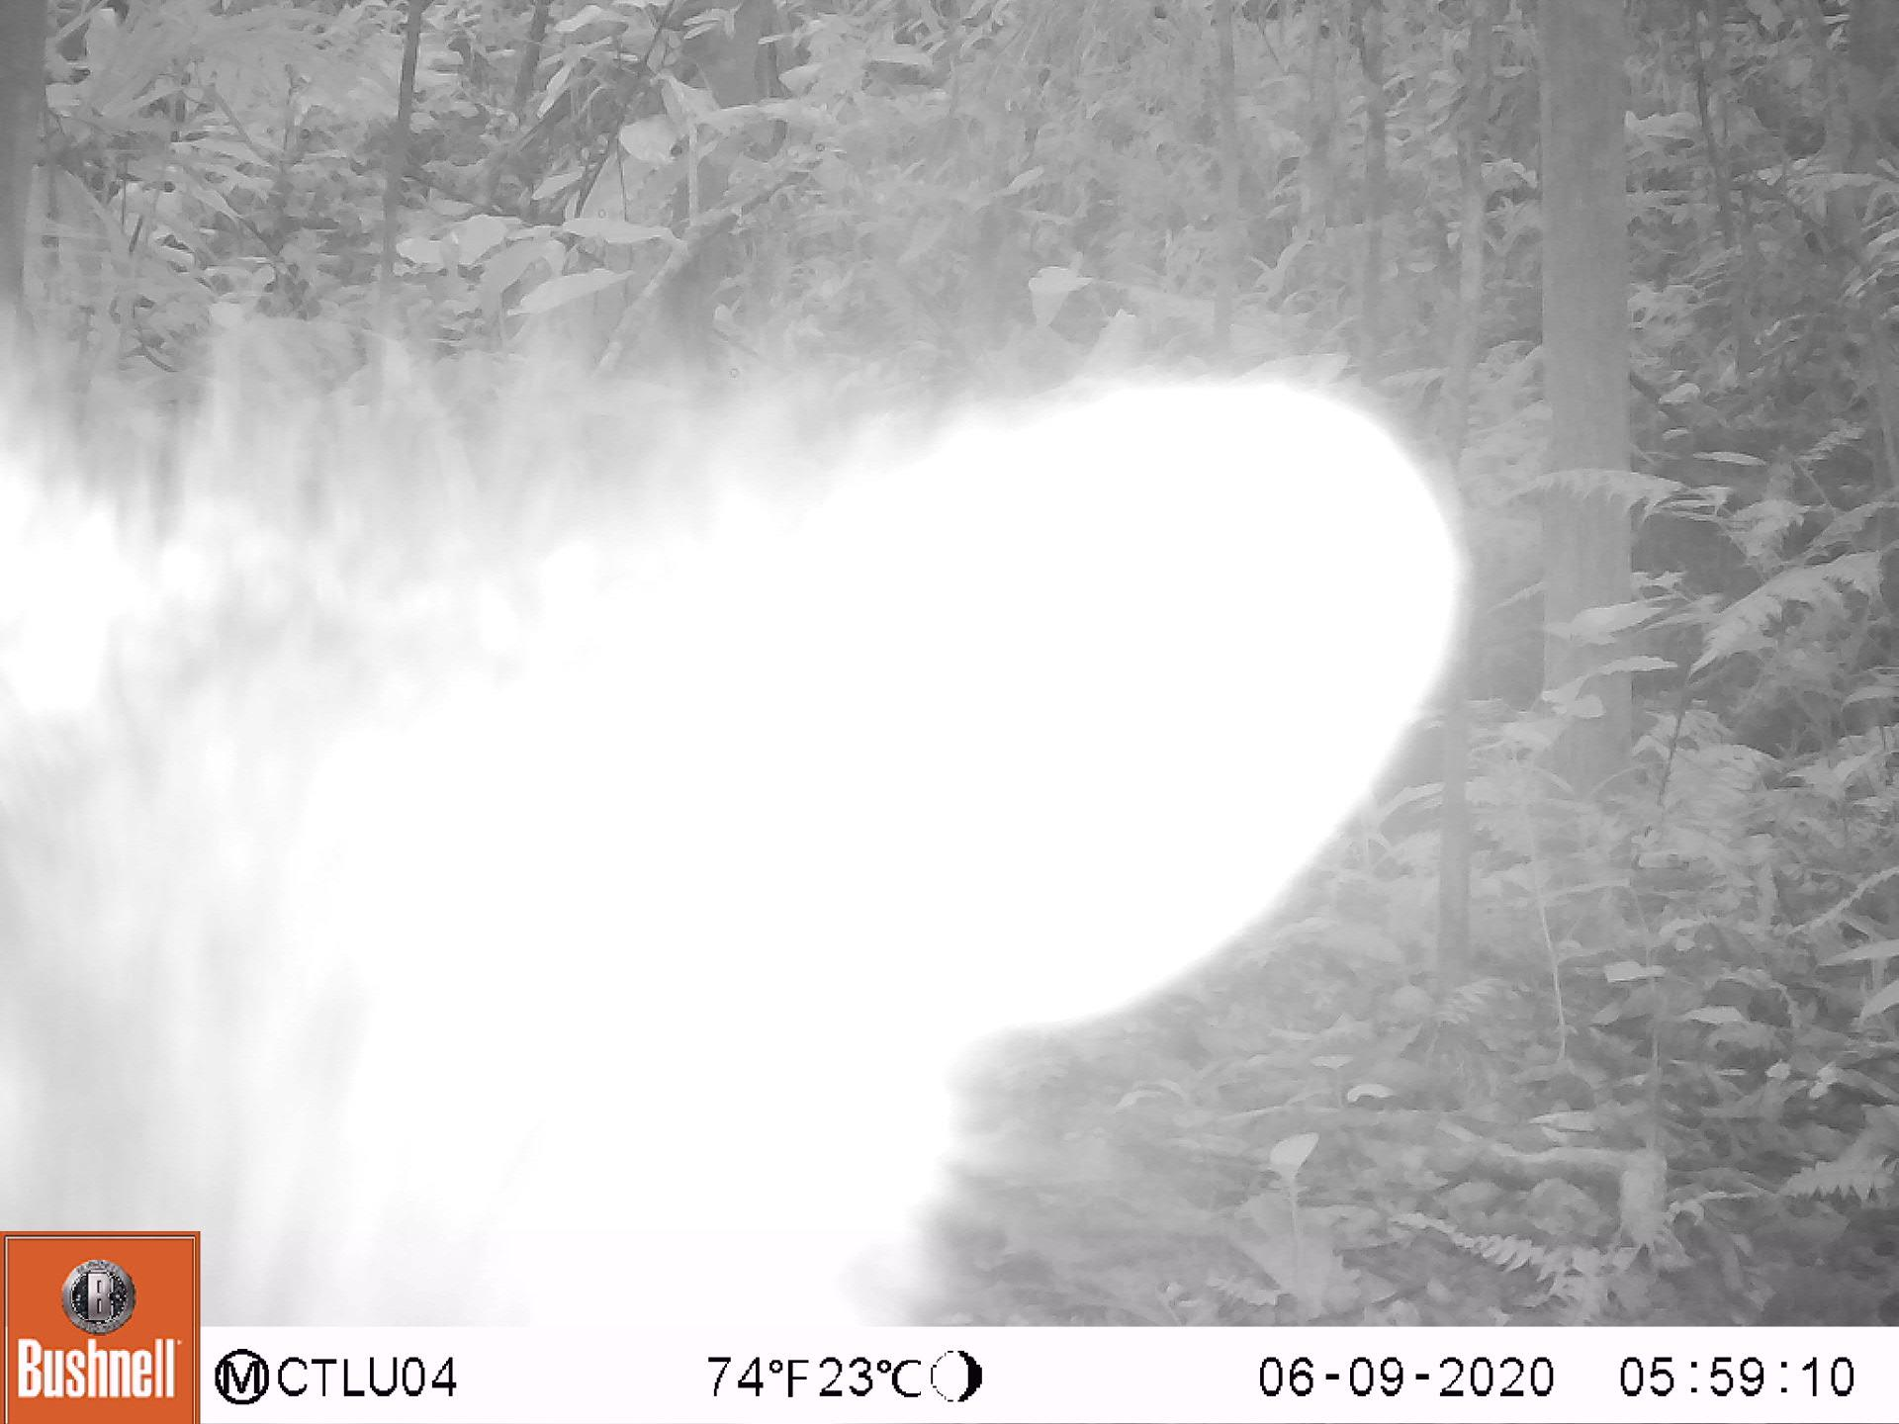
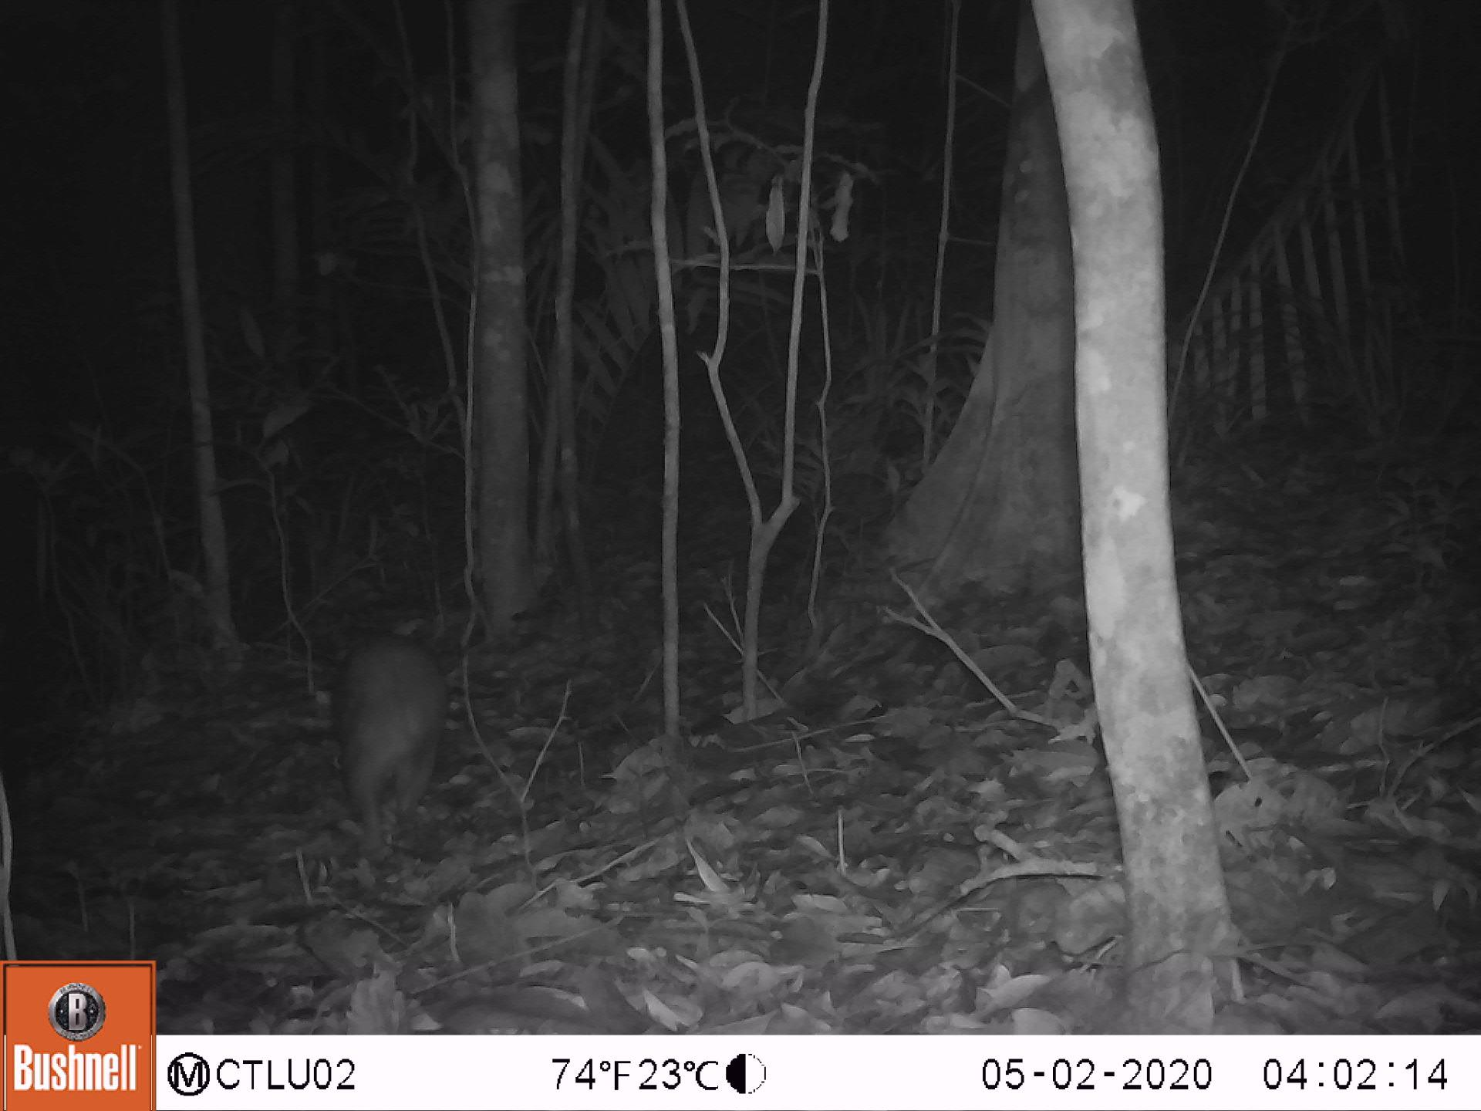
… and their bad days
Black Agouti
Bos species (cow)
Dasypus species (armadillo)
Peccary
South American Coati
Spotted paca
Notes:
Henry
But on the other hand, we were tasked with classifying images like these that are incredibly difficult to visually classify. We therefore were tasked with a difficult problem that required some sophisticated feature extraction.

Slide 8
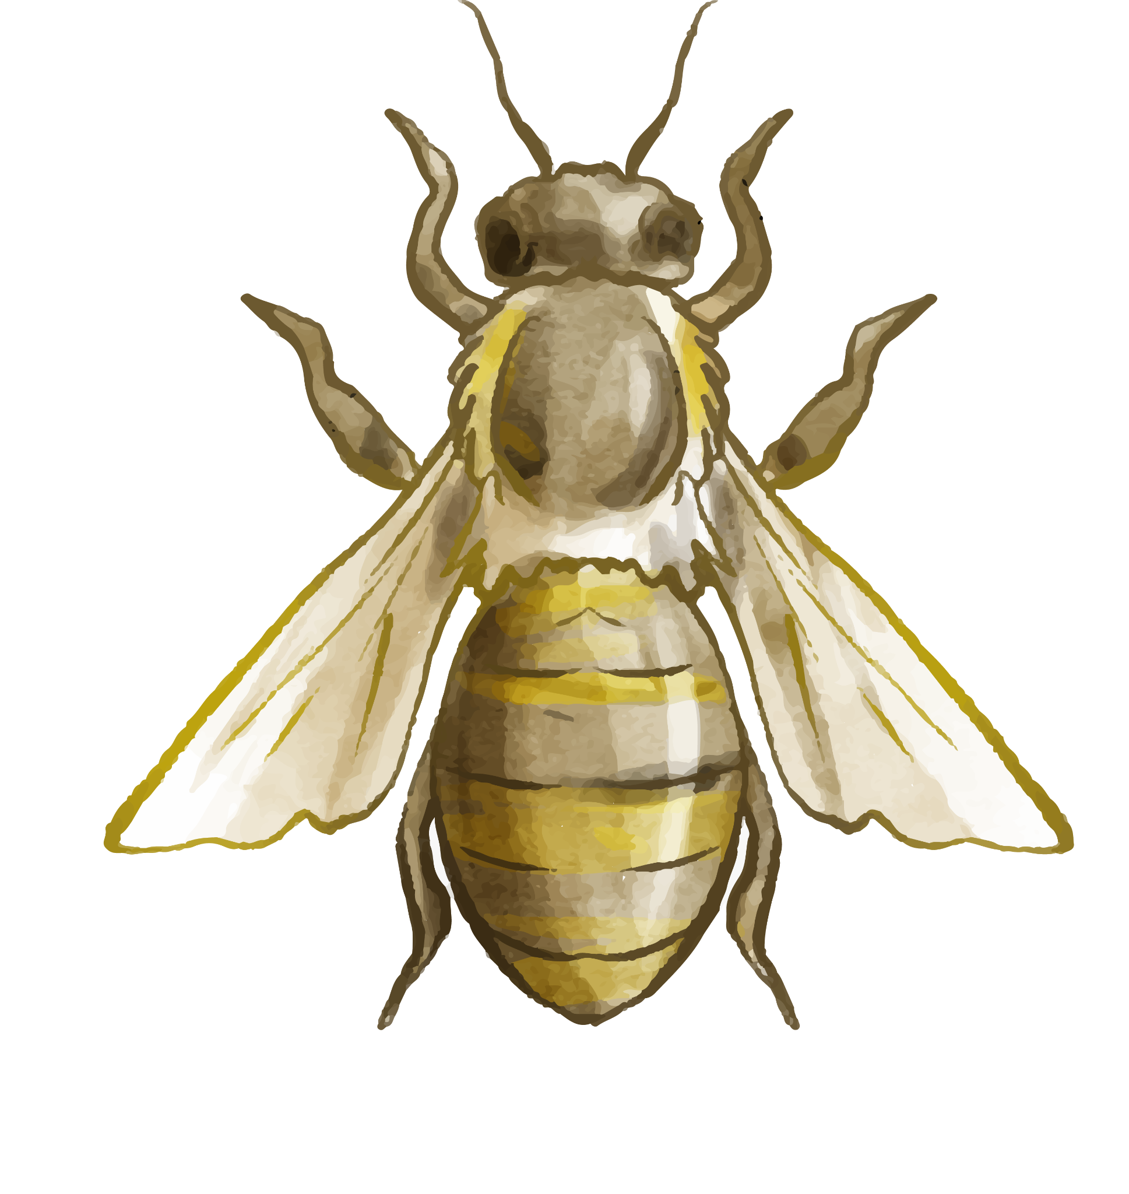
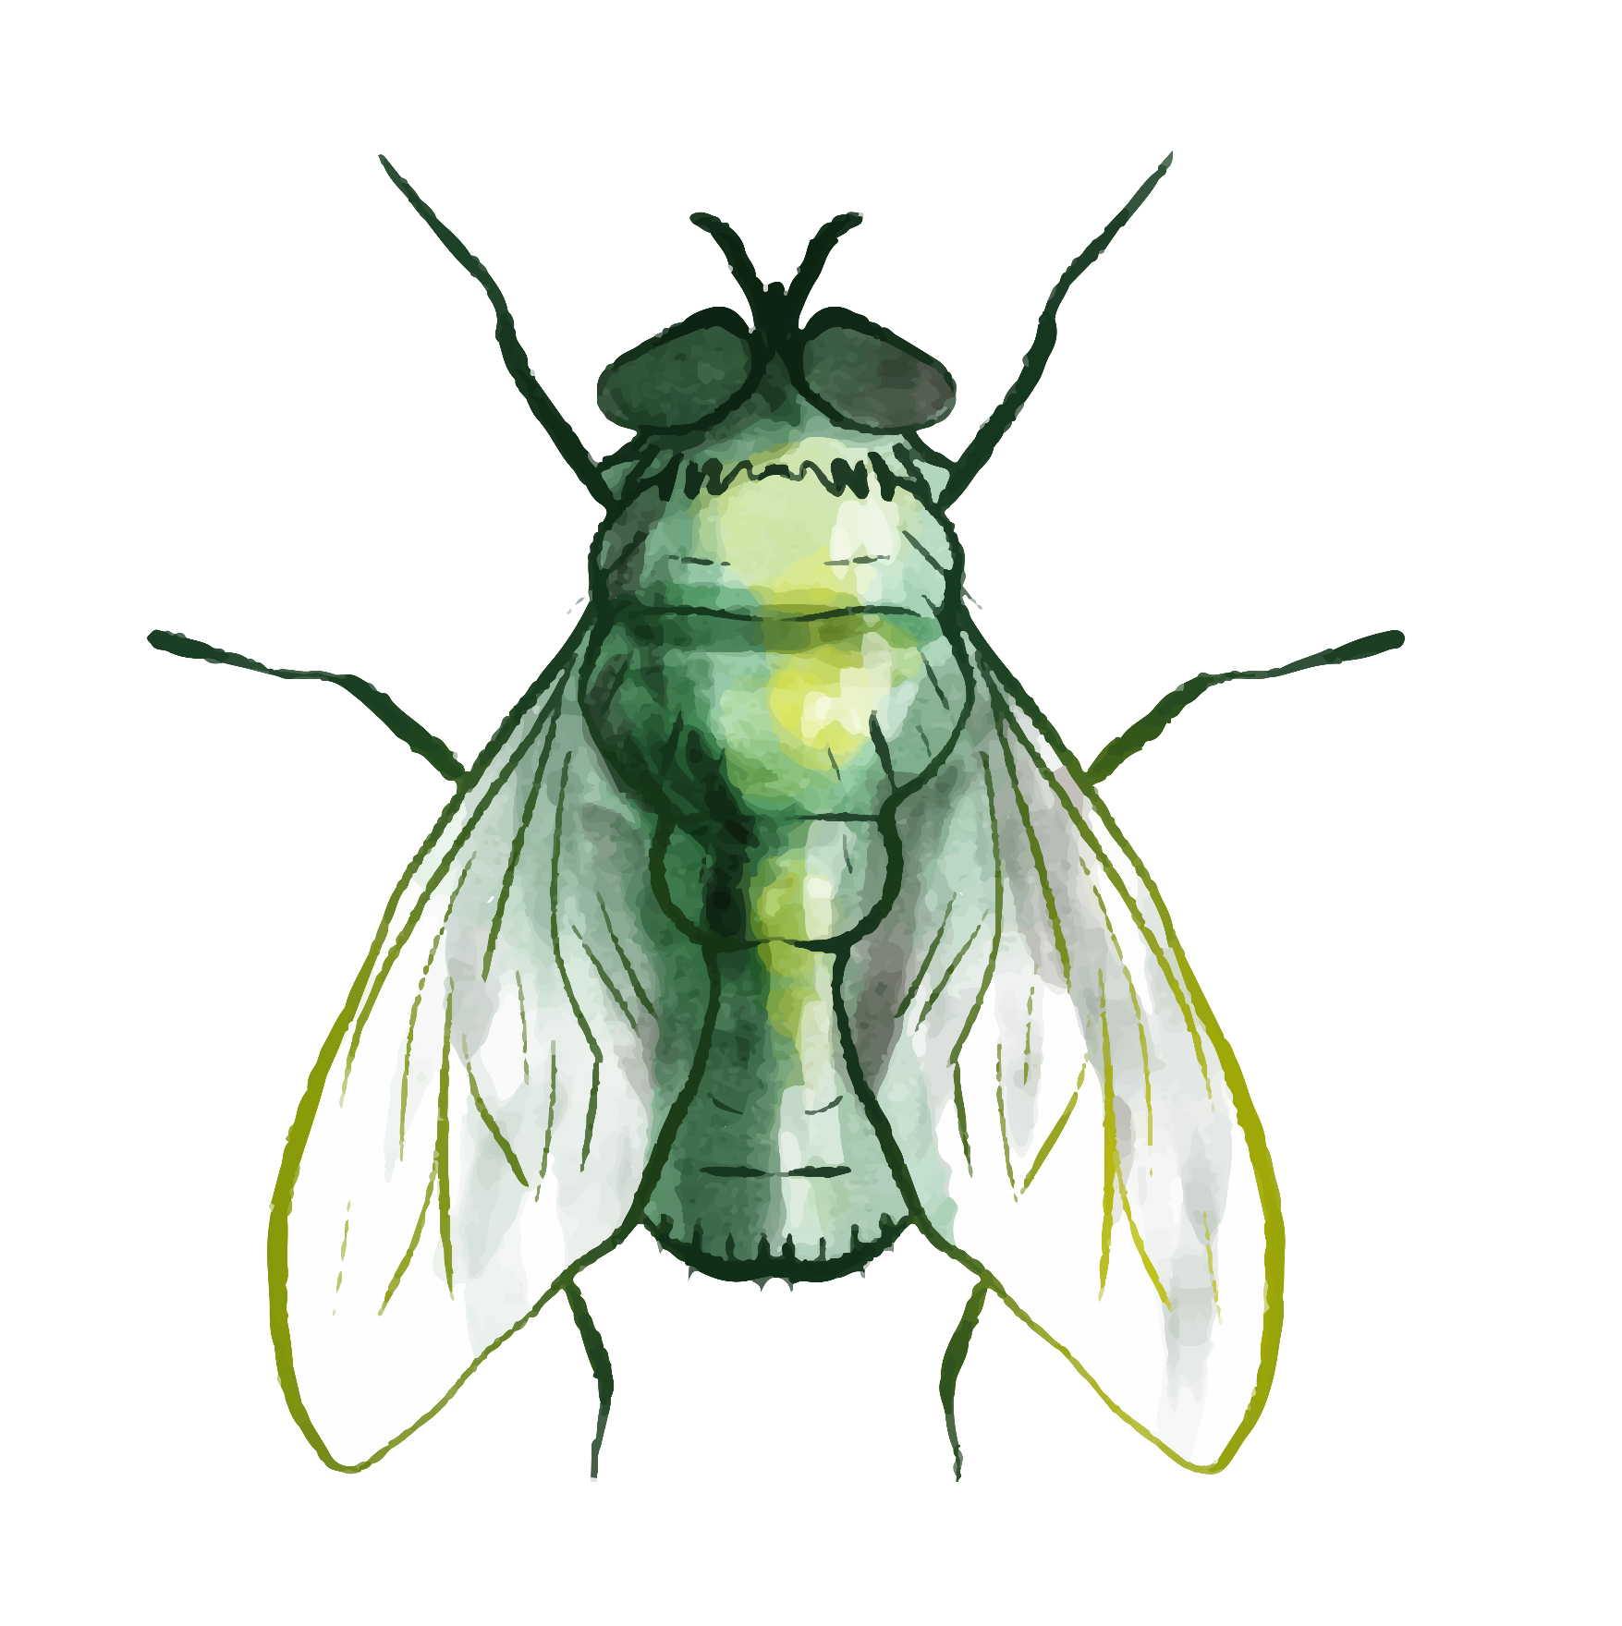
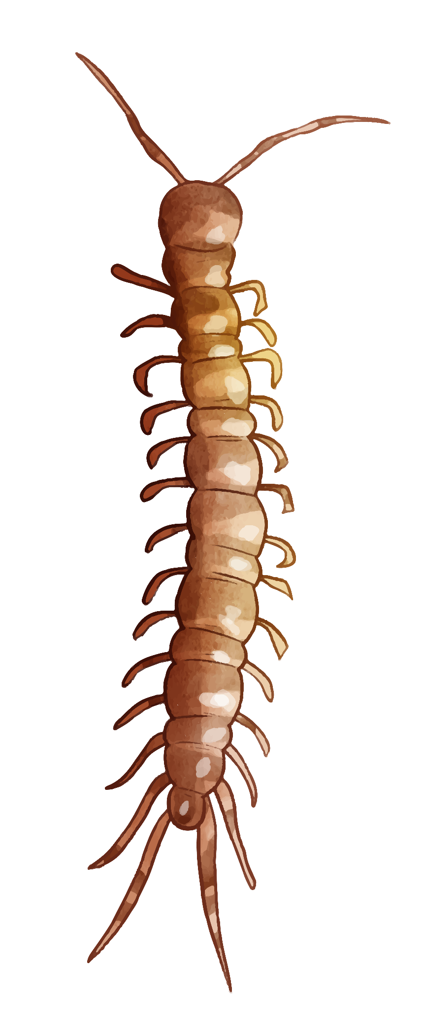
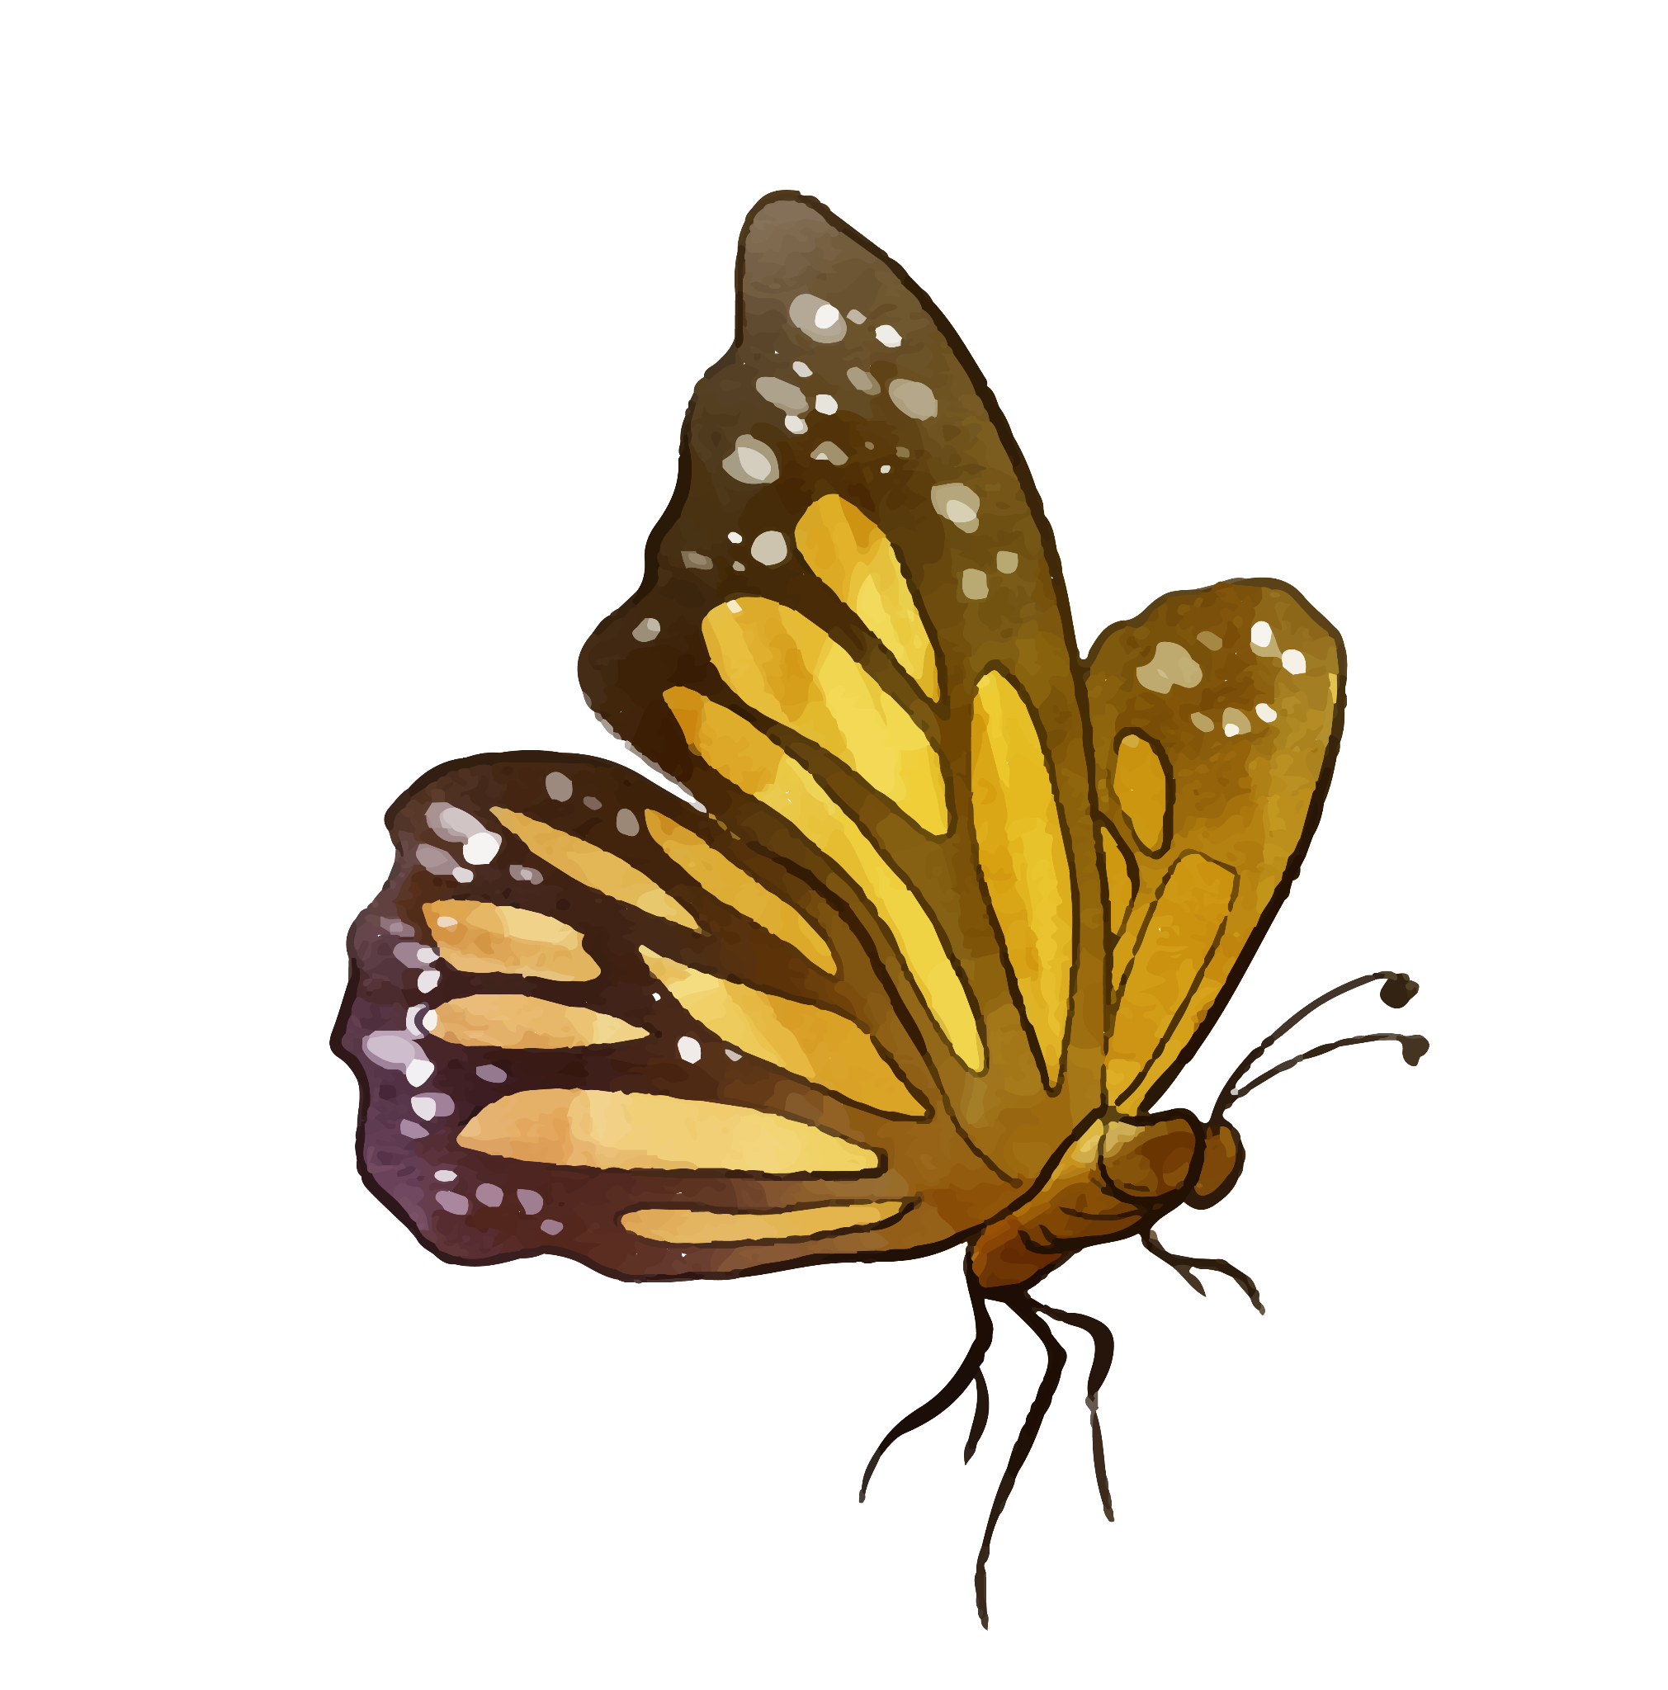
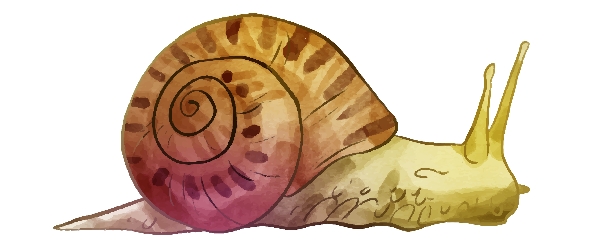
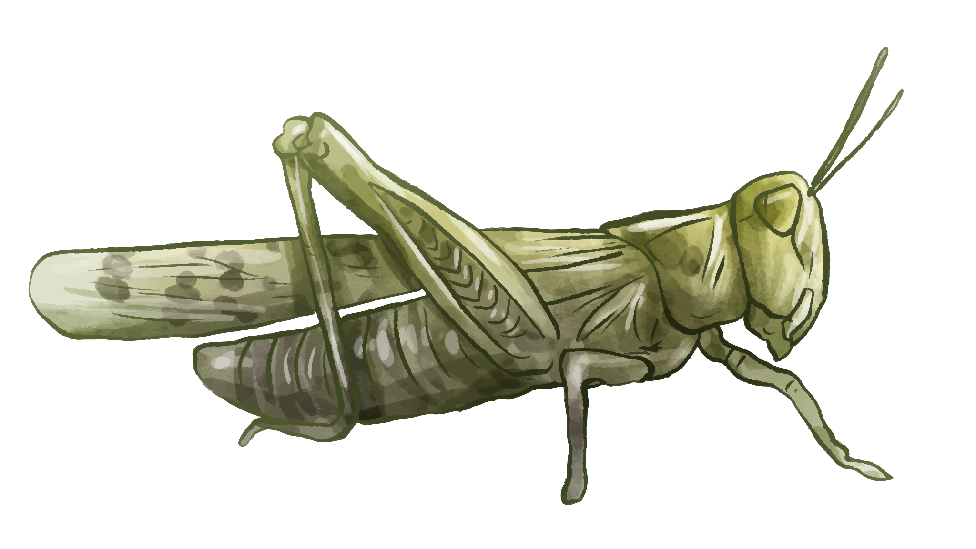
02.
Data preprocessing
Notes:
Eunice

Slide 9
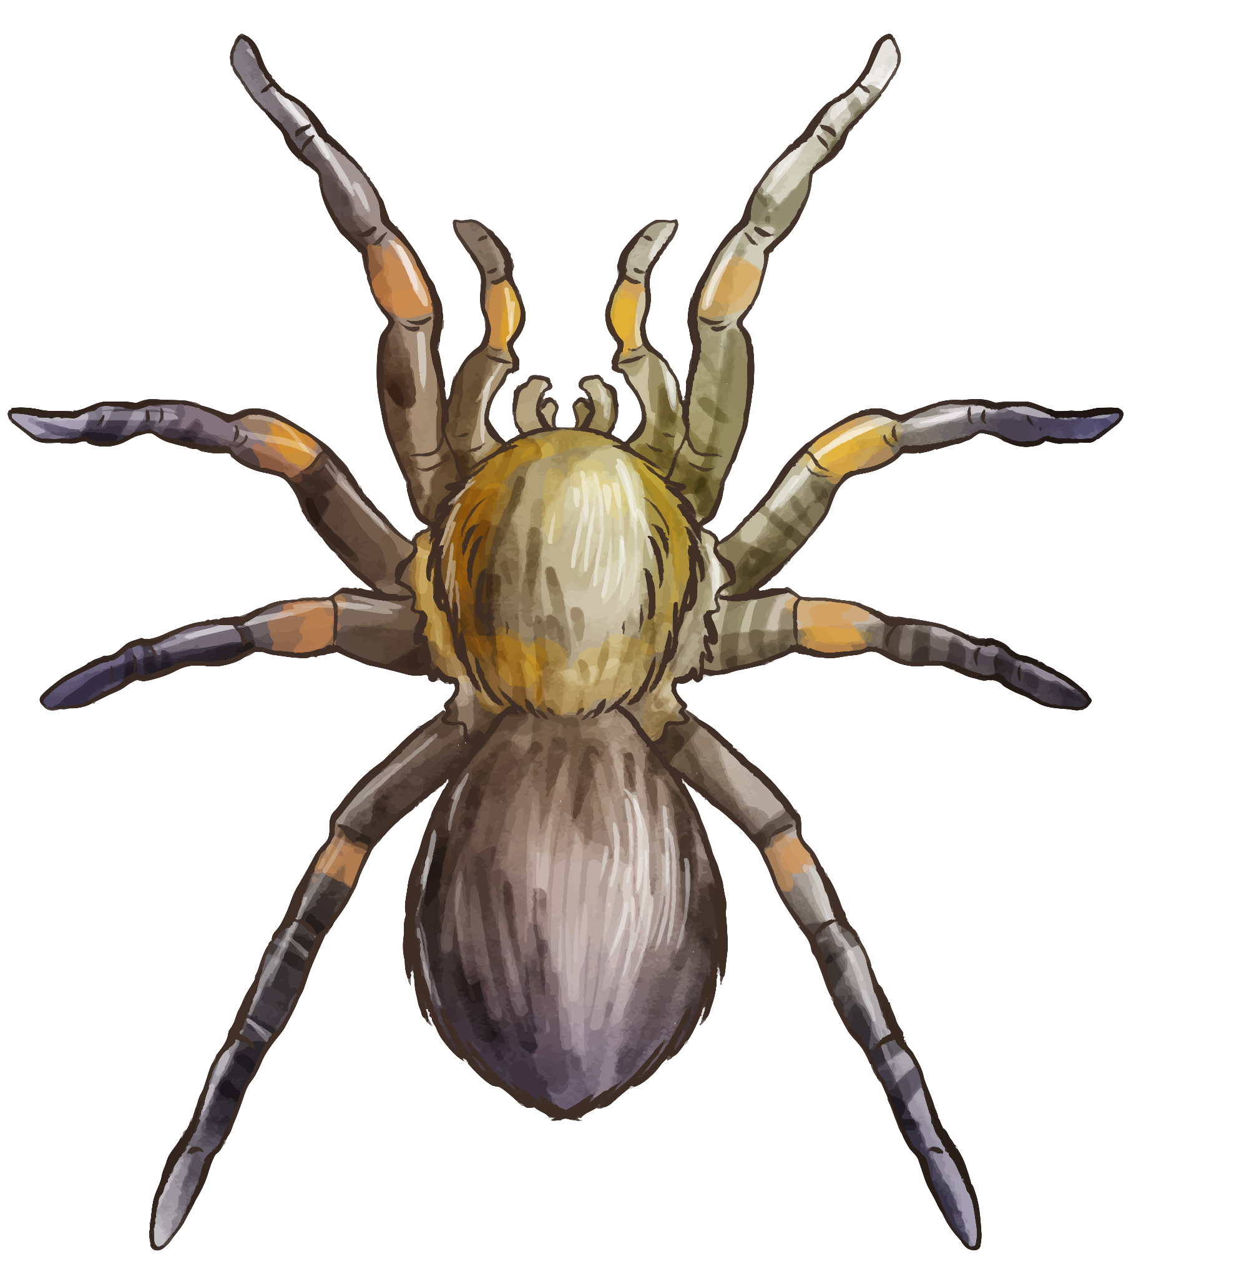
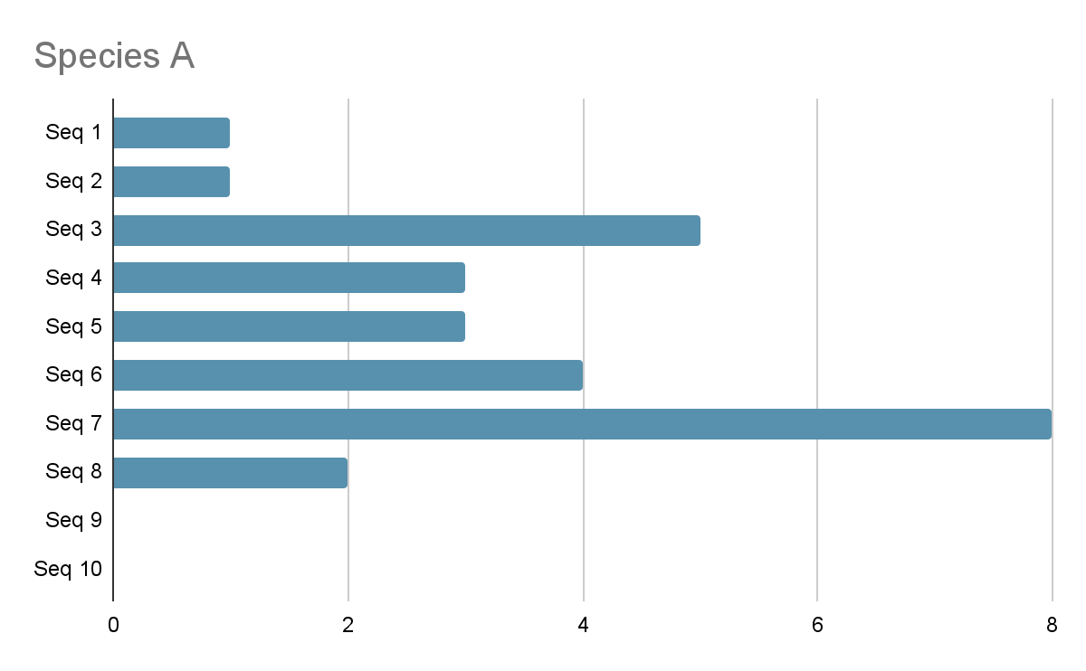
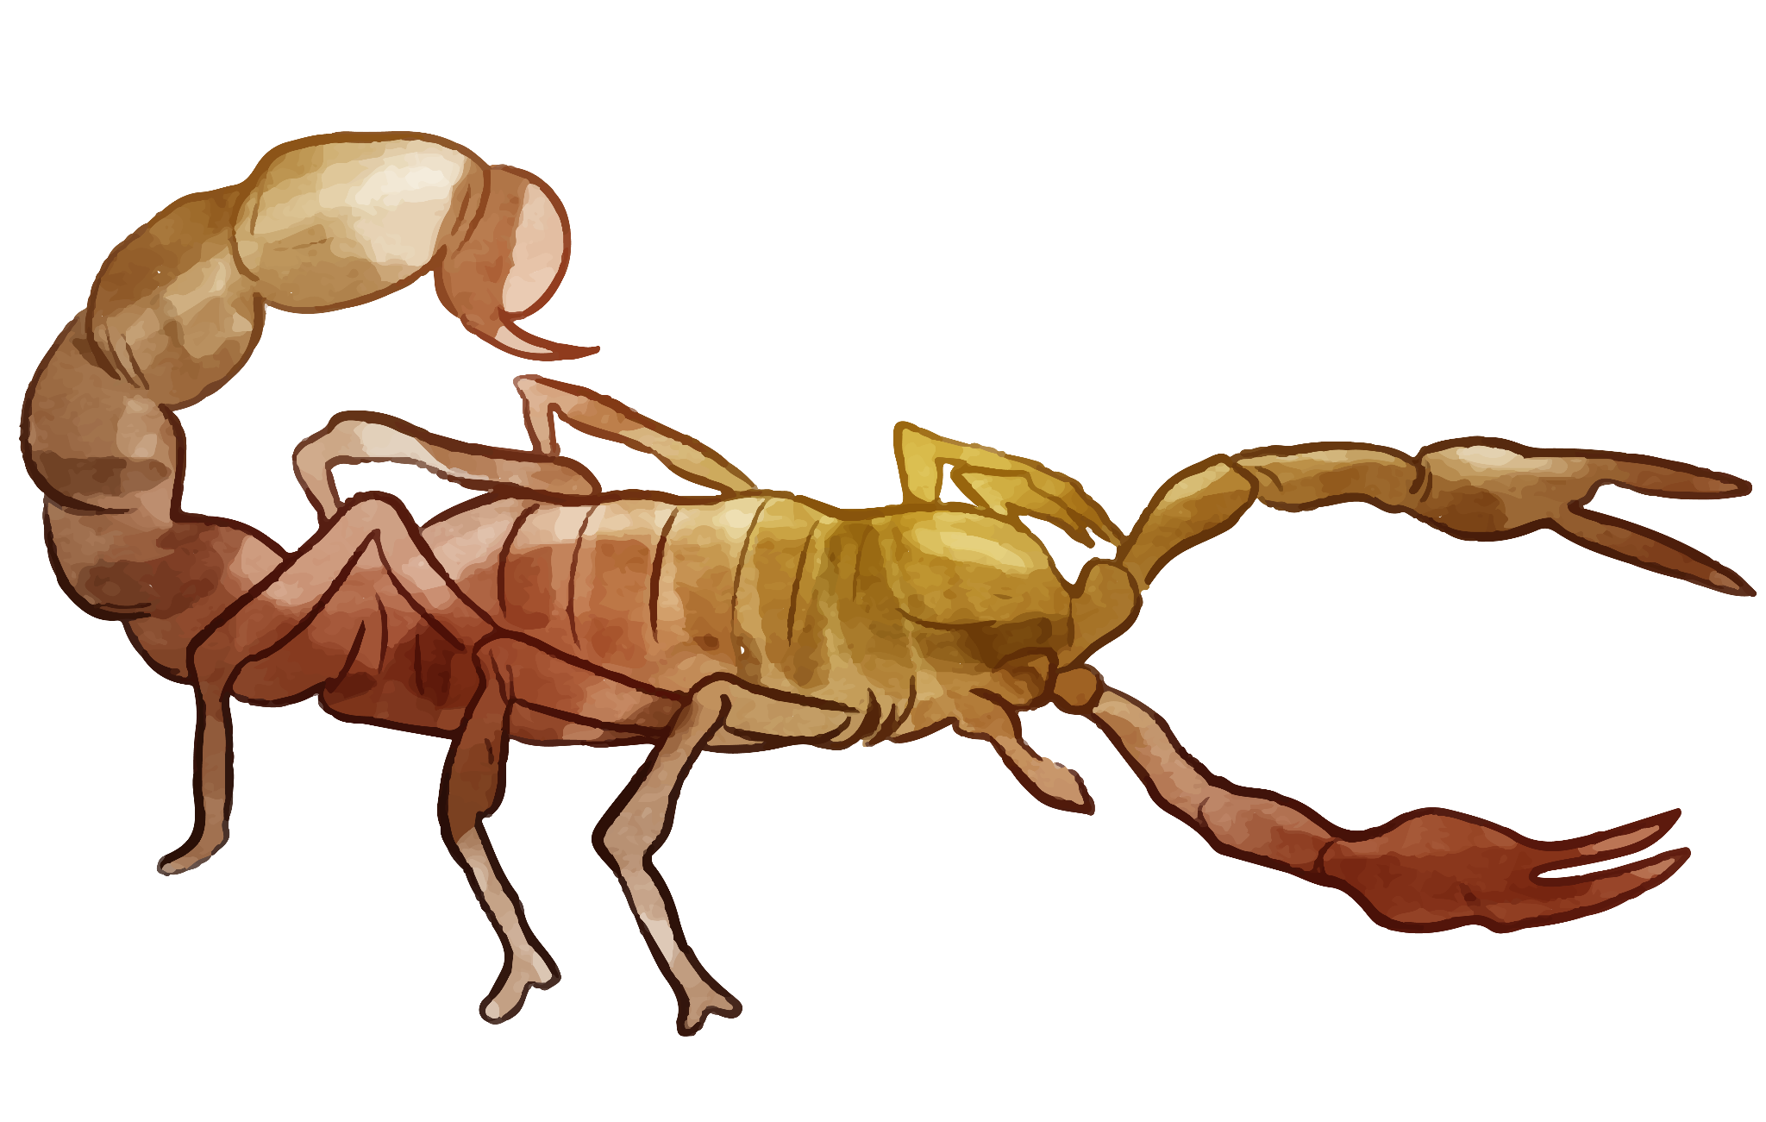
Downsampling
Median = 3
…
Notes:
Eunice
When splitting our dataset, we ensured
The train and test set do not contain Images from the same sequence to prevent data leakage.
For each species with over 1,800 images
we first find median of the length of the sequences for each species.
Then we take the whole sequence of images for sequences shorter than the median
And trim the sequences that are longer than the median.

Slide 10
Splitting
Shuffle
Split
Train
Test
Validation
Notes:
After that we shuffled the groups,
and assigned the groups to train, validation and test set in ratio of 70:10:20
This way we have balanced number of images per species and no data leakage.
Our downsampled dataset has around 1000 images per class.
Next, I will handover to jacqueline to talk about the image pre-processing steps.

Slide 11
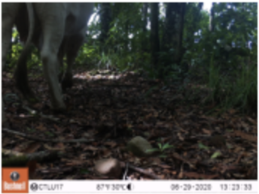
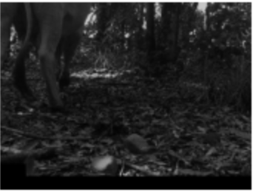
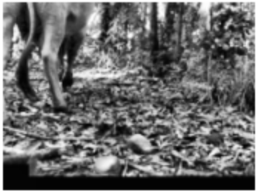
Image Processing
Original
Remove metadata
Histogram equalization (CLAHE)
Leave only red channel
clipLimit=5.0
tileGridSize=(8,8)
Lower resolution (0.1x)
Notes:
Jacqueline (50s)
After splitting the datasets, we performed some processing on the images so to improve the model fairness and quality of features.
Firstly we blacked out the dataset project logo and metadata banner at the bottom of all images as those are unnecessary information.
As the camera traps use infrared flash for capturing images at night-time, those images will have different color and intensity behavior from colored images taken in the day.
To allow more practical analysis without time limitation, we took the red channel of all images only by turning the Blue and Green channel values to zeros.
At the final step of preprocessing, we scaled down the image resolution to 0.1 times and perform histogram equalization to refine the intensity distribution.
We chose to use a variant of adaptive histogram equalization called contrast limited adaptive histogram equalization (CLAHE) for better results.
In this sample image, the shape and posture of the animal is unclear in the original, looking similar to trees at the background, but it became much visible after the preprocessing.

Slide 12
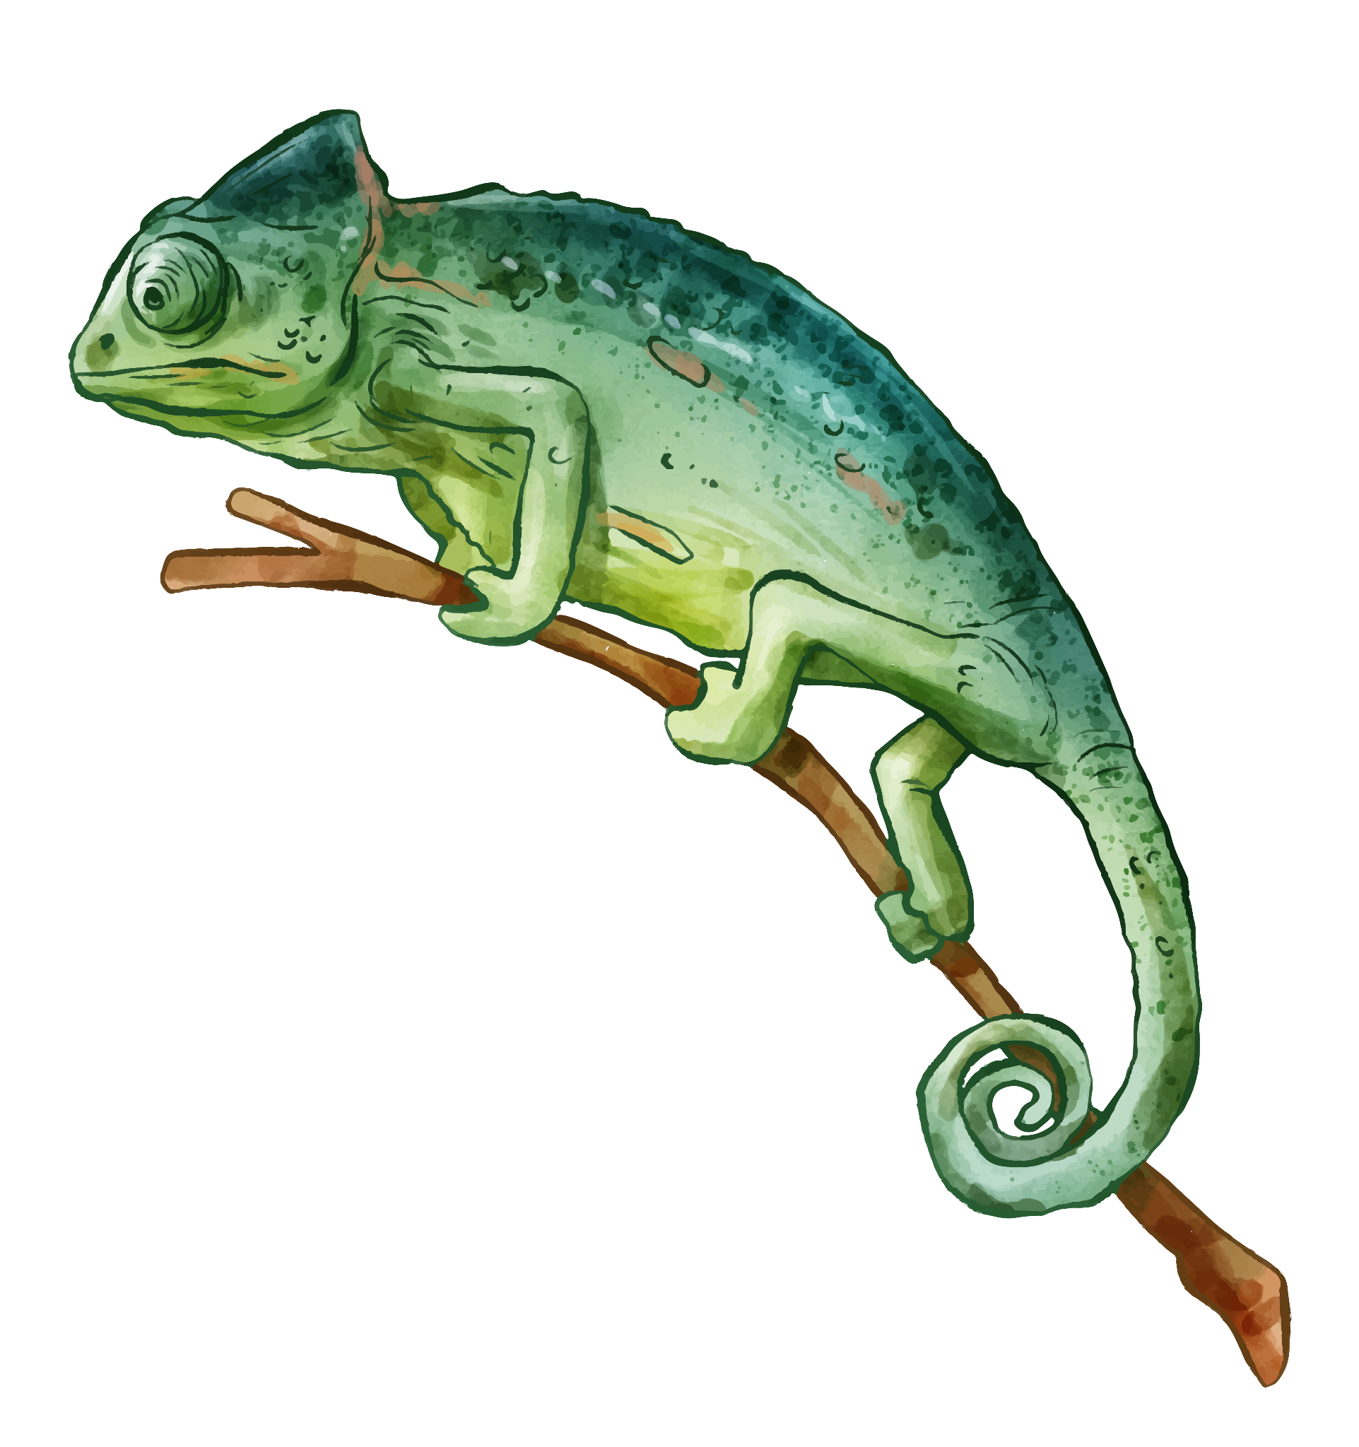
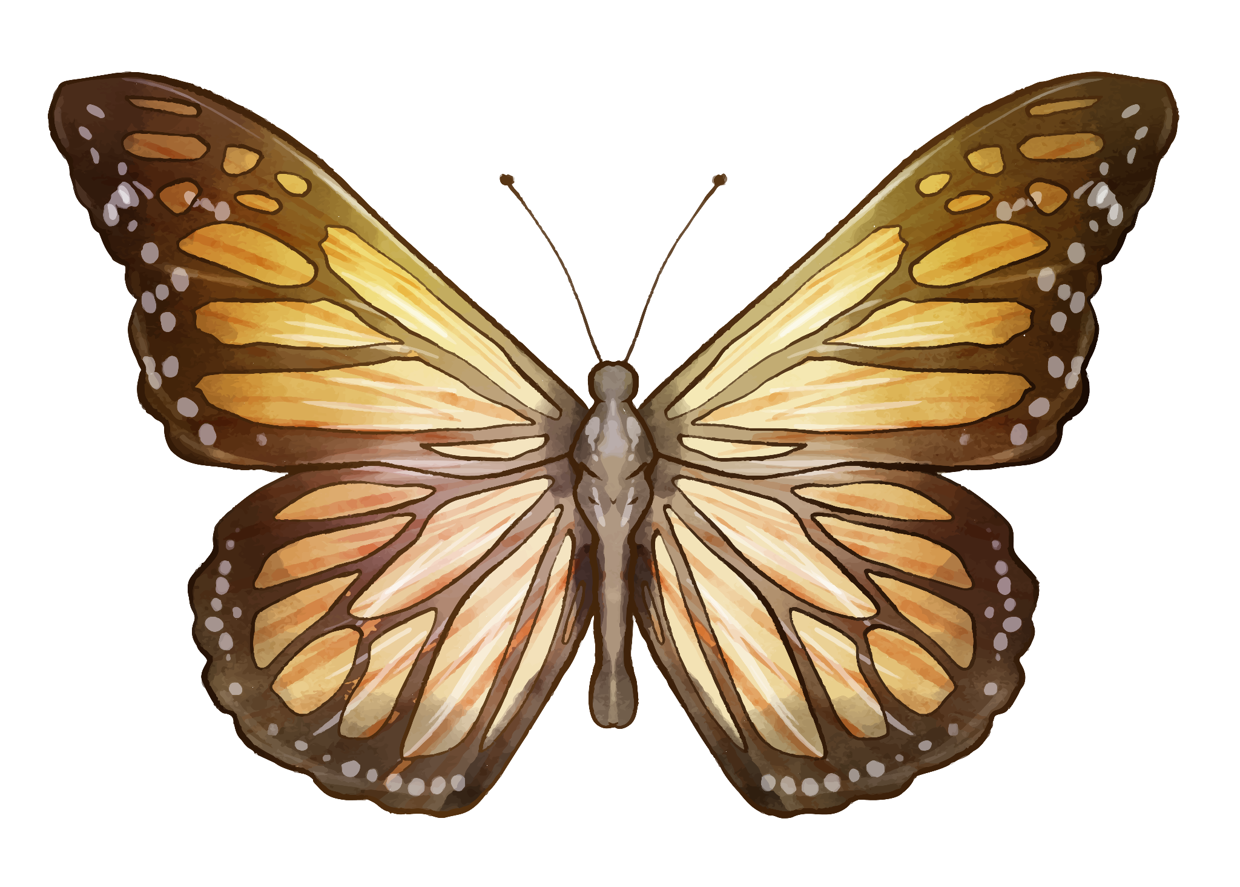
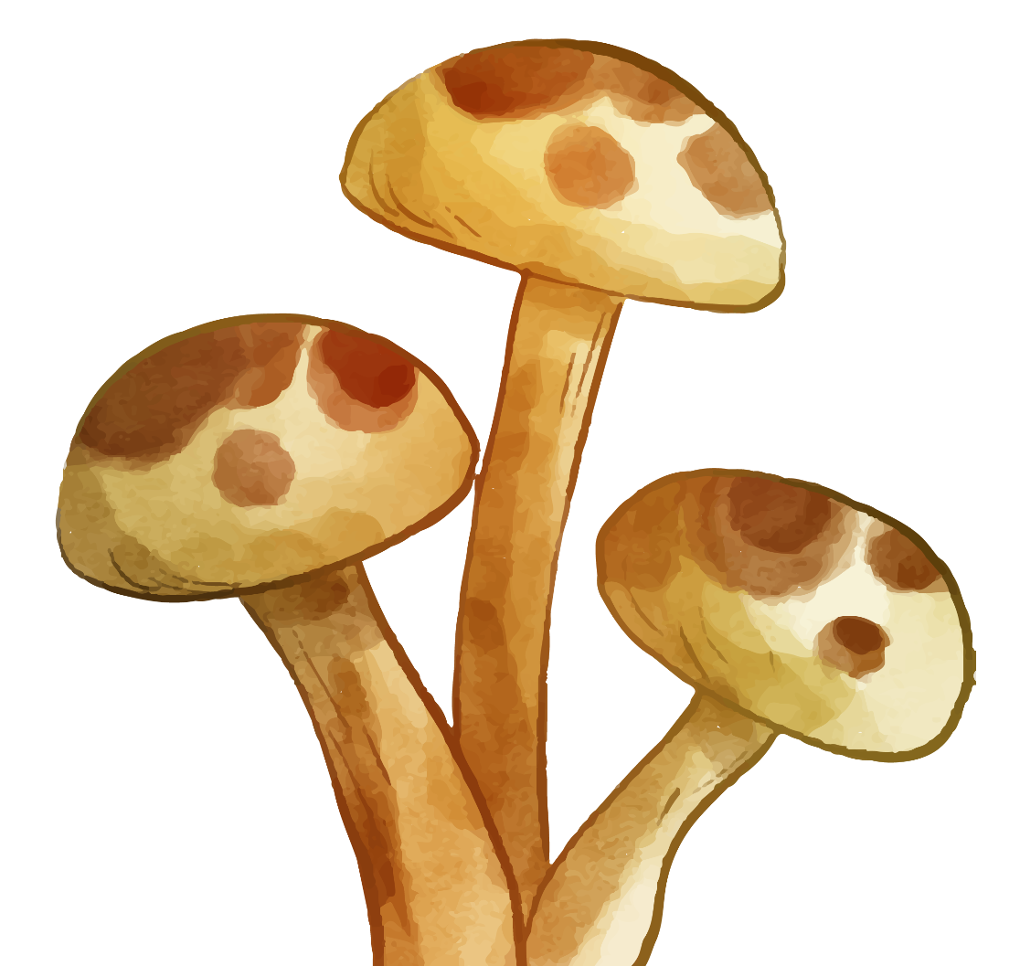
03.
Feature extraction
Notes:
Jacqueline (10s)
We then moved on to feature extraction. For the period of this project we have explored different feature options.
Since we have decided to keep only one of the color channels, some features such as those comparing color channels are not suitable for our case.
Finally we chose to use 4 features.

Slide 13
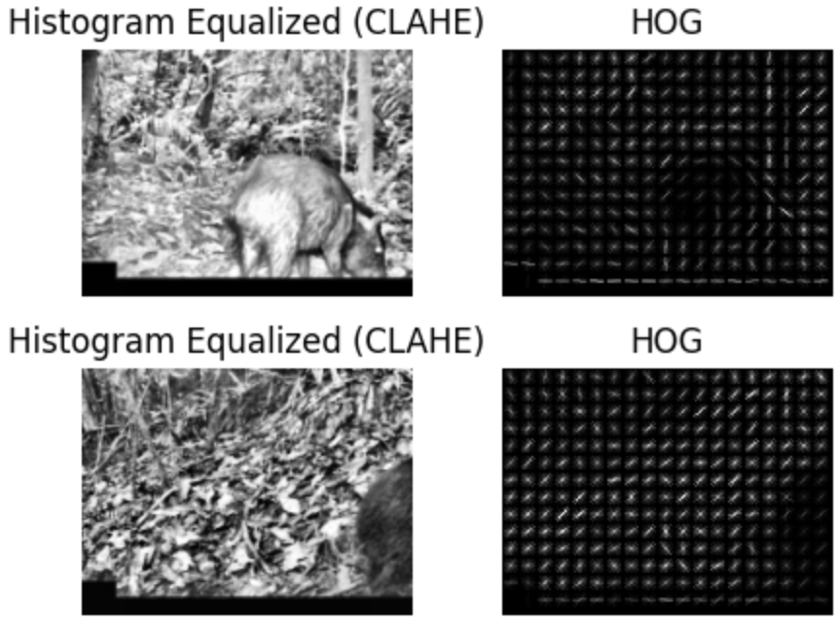
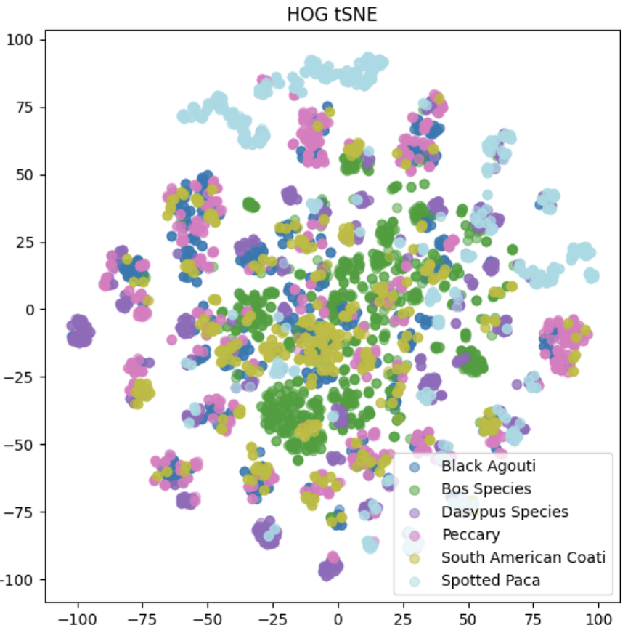
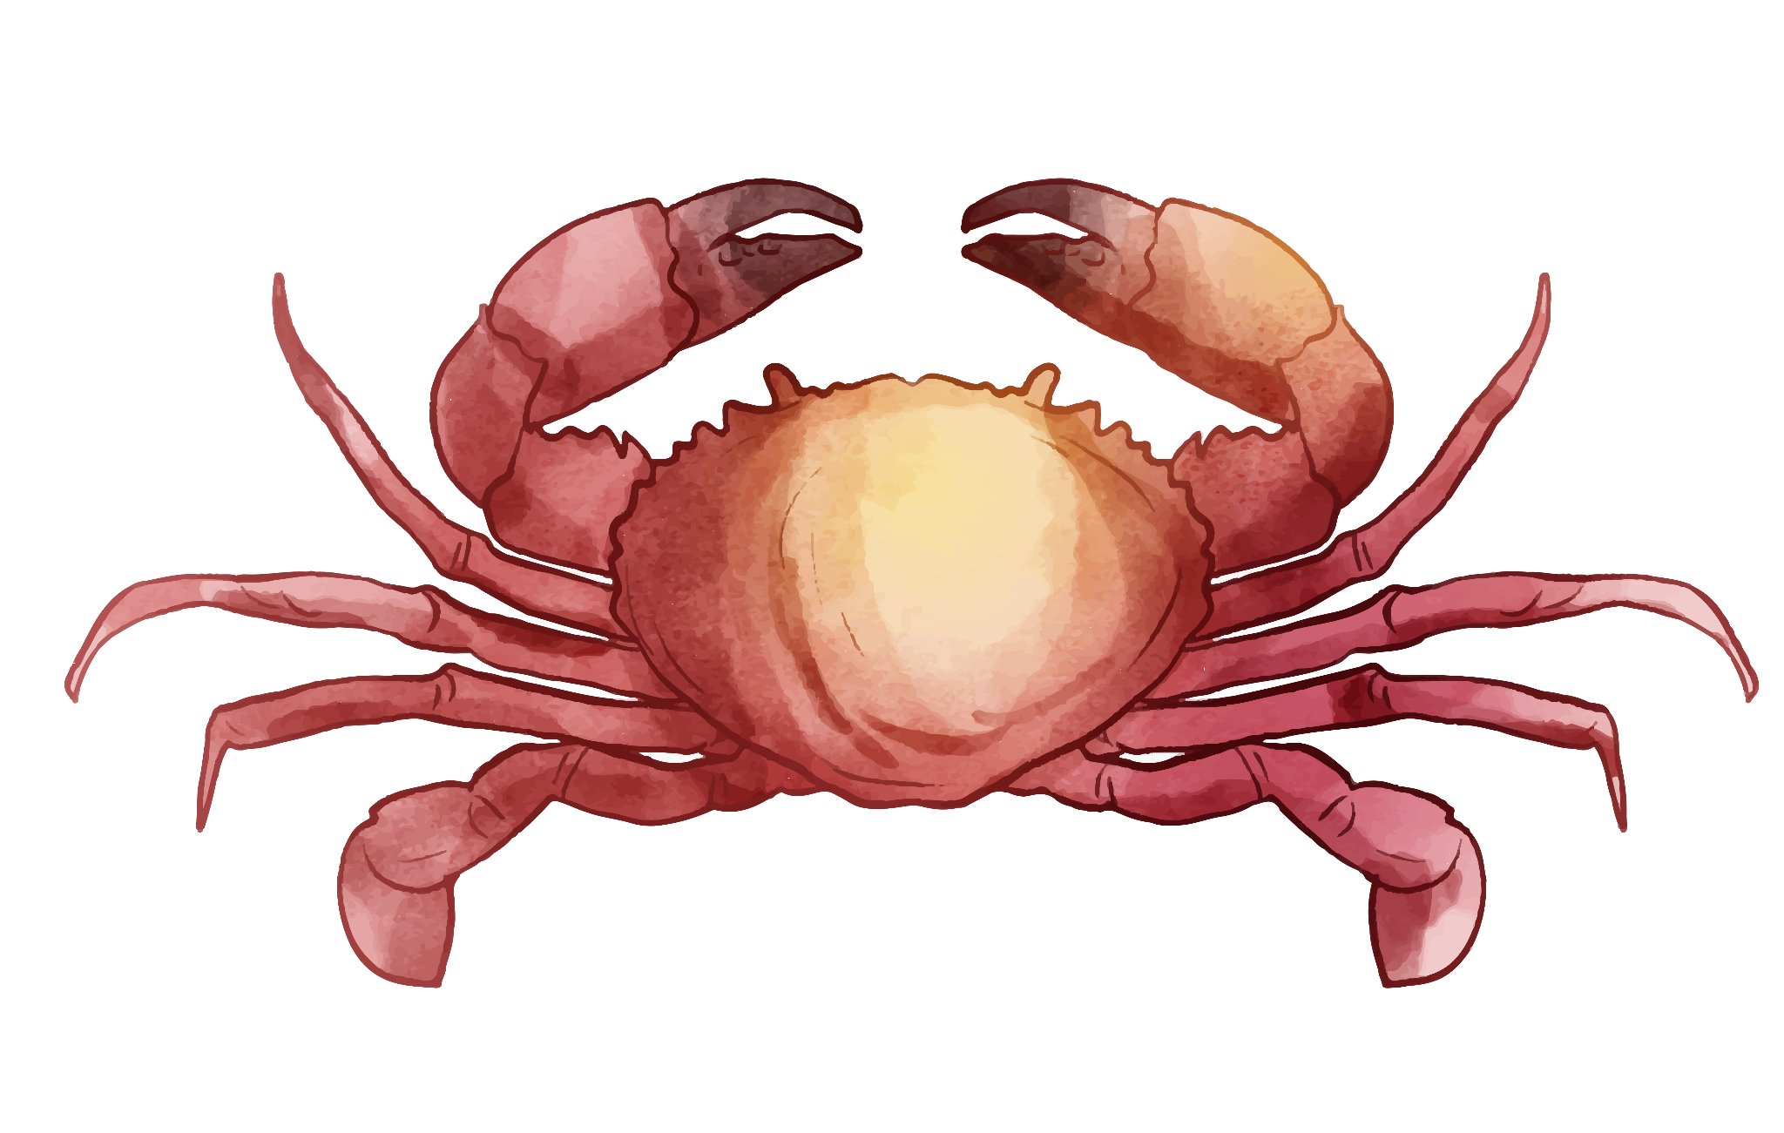
HOG
orientations=8, pixels_per_cell=(10, 10)
Notes:
Jacqueline (15s)
The first feature we chose was HOG - histogram of oriented gradient. It provides information on the edge orientation in localized portions of the image. We used 8 orientations and 10 by 10 pixel blocks as the parameter. From the tSNE plot it seems that that some classes are separated out, showing potential of HOG in our analysis.

Slide 14
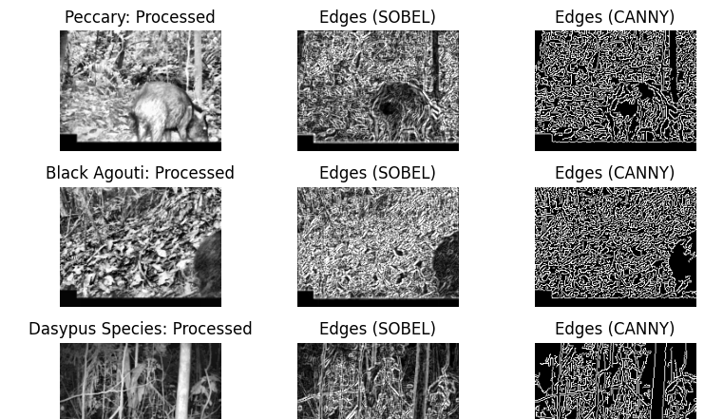
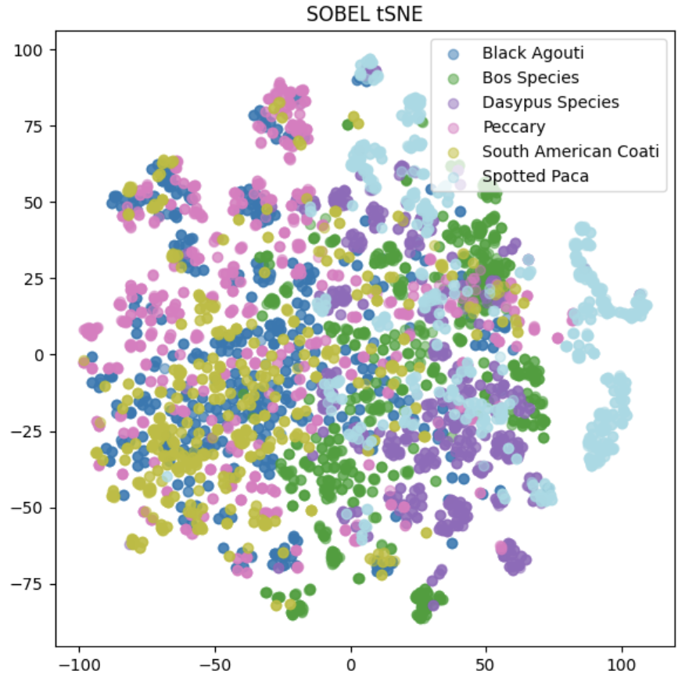
Edge (Sobel, Canny)

Slide 15
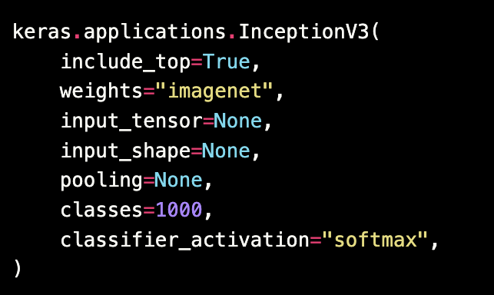

CNN
#load InceptionV3 model and restructure to remove the classification layer
img_model = InceptionV3()
img_model = Model(inputs=img_model.inputs, outputs=img_model.layers[-2].output)
Notes:
Jacqueline (21s)
The third feature we chose was a complex feature obtained from a pretrained CNN model.
We have taken the InceptionV3 model from the keras library, which is the third edition of Google's Inception CNN, originally introduced during the ImageNet Recognition Challenge.
We passed the preprocessed images into the Inception model, and took the embeddings from the third layer from the last for use, since the last 2 layers of the CNN model was pooling and classification.

Slide 16


SIFT
Sigma = 5
Octave layers = 5
Contrast threshold = 0.01
Edge threshold = 20
Num clusters = √number of files
Notes:
Juliana (42´´)
We performed SIFT with bag of visual words and applied weights to the descriptors using TF-IDF, aiming to reduce descriptors related to the background, while focusing on the animals.
We noticed that these hyperparameters worked best when creating our descriptors. We increased our thresholds to include more keypoints, and to focus on rounder objects (animals), while not considering more jagged edges (grass). We increased octave layers to account for different distances to the camera, as animals could be found up close or far away. A low sigma produced more descriptors, particularly in the background, so the value was increased.
We experimented with with different cluster sizes for the BoVW clustering, but found that the square root of the number of files got the best performance.

Slide 17


Dimensionality reduction
Notes:
Juliana (30”)
We performed PCA on each of our 5 feature vectors, and selected the number of components that explained 95% of the variance for each of the vectors as seen here. We then stacked those feature vectors into our data matrix, to perform classification using different models.
Our PCA and tSNE results would suggest a better class segmentation with HOG, but a faster classifier with CNN and SIFT.

Slide 18


04.
Classifiers
Notes:
Eunice

Slide 19

Comparison
Model | Parameter | Search values | Best value | Best accuracy | Model Time
LDA | solver | svd, lsqr, eigen | lsqr | Train: 0.75997 Test: 0.7748 | Training: 121.7246 s Inference: 0.0152 s
 | shrinkage | auto, 0.2, 0.4, 0.6, 0.8 | 0.4
 | n_components | None, 1, 2, 3, 4, 5 | None
 | tol | 1e-4, 1e-5, 1e-6 | -
SVM | kernel | linear, rbf | rbf | Train: 0.7624 Test: 0.7586 | Training: 102.2918 s
 | C | 0.001, 0.5 , 1, 10, 50 ,100 | 1
Notes:
Eunice
We trained three models:
Linear Discriminant Analysis,
Support Vector Machine and
Also adopted neural network as our deep learning model.
Grouped Search Cross Validation for searching suitable parameters.
One-vs-Rest (OVR) approach for SVM training,
after considering the test set accuracy and training time, our best model is SVM, with train accuracy reaching .76 and test accuracy .758

Slide 20
Comparison
Model | Parameter | Search values | Best value | Best accuracy | Model Time
NN | activation | relu, tanh, linear | relu | Train: 0.7453 Test: 0.7653 | Training: 10.7483 s Inference: 0.1899 s
 | neurons | 100, 200, 300 | 300
 | weight_constraints | 2.0, 3.0, 4.0 | 2.0
 | dropout_rate | 0.2, 0.4, 0.6 | 0.2
Notes:
Eunice
Here are the parameters and search values of our neural network are shown here.
We have tried using different activation functions,
Jacqueline will cover more detail about the neural network later.

Slide 21



LDA
Best performing model:
Train on all features over 5 folds.
Lease Square LDA with shrinkage = 0.4.
Train Set
Test Set
Notes:
Eunice
This show the model result of the LDA.
We trained the LDA model using all features over 5 folds Group Cross Validation Search.
Our best model is a Least Square Solver with shrinkage of 0.4.
The confusion matrix of the train set shows the model fit the classes well.
On the right are the ROC curve and confusion matrix for the test set.
Our model is best in identifying Bos Species, and often confuse Peccary, South American Coati and Dasypus species.
This pattern is very similar with the SVM model, which Juliana will share the result with you next.

Slide 22



SVM
rbf, C = 1, K = 3
Test Set
Feature | Train | Test | Time (s)
All | 0.7624 | 0.7586 | 102
HOG | 0.7647 | 0.7876 | 487
Sobel | 0.7549 | 0.7408 | 1100
CNN | 0.6620 | 0.6449 | 20
SIFT | 0.5332 | 0.5217 | 4.2
Notes:
Juliana (30”)
Our best performing model, in terms of accuracy, was the rbf SVM with C=1: It had comparable results to the HOG-only vector model, but with higher computational performance.
As Eunice mentioned before, we noticed that our SVM model did best in classifying cows both in in our test set (shown here) and in our train set, and struggled in telling black agoutis and peccaries apart (both are round and black), as well as spotted pacas and dasypus (both are nocturnal).

Slide 23




SVM - Gap analysis
SIFT
HOG
CNN
SOBEL
Notes:
Juliana (28”)
The SIFT-only model struggled in identifying cows, probably because their edges (legs) were a frequent descriptor which was discarded from the TF-IDF based on their frequency.
Our HOG-only model struggled with animals in movement.
Our Sobel-only model struggled with many trees in the background: the image circled here is a coatí, whose edges are invisible in the Sobel feature image.
Our CNN-only model struggled with images from two of the cameras (A01 and N24), getting all images wrong. These cameras were set up in places with lot of undergrowth, as you can see in the image on the bottom left.

Slide 24


NN
Best performing model:
Notes:
Jacqueline (28s)
Apart from LDA and SVM, we also explored the use of simple neural network in the classification.
The model consists of one hidden and one dropout layer between the input & output layers.
With weight constraints applied as one of the parameters in grid search, along with number of the activation function to use, neurons used in the hidden layer and dropout rate.
Although achieving over 75% accuracy in training and testing.

Slide 25
NN - Gap analysis
Black Agouti
Peccary
South American Coati
Dasypus species (armadillo)
Spotted paca

Slide 26



Conclusion and future works
3 different model approaches
>75% test accuracy!
Image differencing/more feature extraction
Fix mislabeled images
Notes:
Henry
As we discussed, we took 3 main model approaches to incorporate the class learnings into a heavily unbalanced dataset. Even with the class similarities and the severe discrepancies in the animal orientation, we were able to achieve over 75% test accuracy! But with this, there are several things we can do to improve, which include more sophisticated feature extraction methods such as image differencing to account for motion blur and fixing the mislabeled images. Although there were only a few mislabeled images, this is definitely something crucial to address before employing any other model approaches.

Slide 27



Thanks!
Any questions?
Notes:
Henry

